Slide 1
Physics Momentum Problems
FACULTY OF EDUCATION
Department of
Curriculum and Pedagogy
Science and Mathematics Education Research Group
Supported by UBC Teaching and Learning Enhancement Fund 2012-2013
Notes:
Categories: Secondary – Physics – Momentum
Tags: conservation of momentum, elastic and inelastic collisions, energy, forces
Excerpt: Use these physics problems to test your knowledge on momentum and collisions

Slide 2
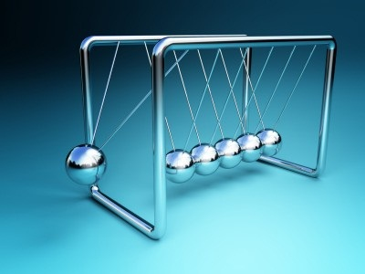
Question Title
Momentum Problems
Question Title
Retrieved from: http://www.two-it.com/the-momentum-is-building/

Slide 3
Question Title
Momentum Problems
Question Title
The following questions have been compiled from a collection of questions submitted on PeerWise (https://peerwise.cs.auckland.ac.nz/) by teacher candidates as part of the EDCP 357 physics methods courses at UBC.

Slide 4
Question Title
Momentum Problems I
Question Title
Two cars of equal mass (1100 kg) and speed (36 km/h) collide head on in a completely inelastic collision.
What is the vector sum of the momentum of the system of two cars after the collision?
0 kg.m/s
11,000 kg.m/s
22,000 kg.m/s
39,600 kg.m/s
79,200 kg.m/s

Slide 5
Question Title
Solution
Question Title
Answer: A
Justification: This is an example of an inelastic collision. In these types of collisions kinetic energy is not conserved (it is converted into some other form of energy, such as heat energy or energy of deformation). However, no matter if it is an elastic collision (kinetic energy is conserved) or an inelastic collision, momentum would still be conserved.
Momentum, being a vector quantity, has both a magnitude and a direction. Momentum is defined as “mass in motion” and thus depends on the mass and velocity of the object. Since the cars were of equal mass and travelling towards each other at the same speed when they collided we know their momentums were equal in magnitude and opposite in direction. Therefore the vector sum of their momentum of the system before the collision would be zero.

Slide 6
Question Title
Solution continued
Question Title
Due to conservation of momentum, we know that the momentum of the system must be equal before and after the collision, therefore the vector sum of the momentum of the system after the collision would also be zero (answer A).
We can solve this without performing any calculations, but here is the solution using numbers:
First we convert km/h to m/s:

Slide 7
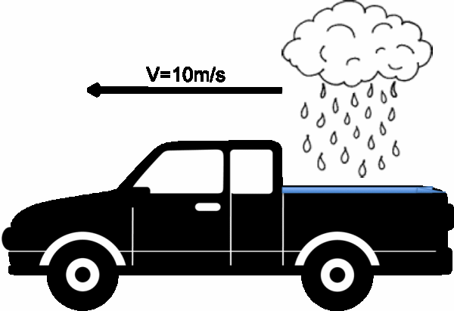
Question Title
Momentum Problems II
Question Title
Suppose you are driving your pick up truck to the store when rain begins to fall vertically from the sky into the bed of your truck.

Slide 8
Question Title
Momentum Problems II continued
Question Title
If you have set Cruise Control to 10 m/s what will happen to the kinetic energy and momentum of the truck as a result of the accumulating rain in the bed of the truck? You can assume that the road you are driving on has negligible friction and that you can ignore the effect of the rain droplets hitting the front of the vehicle.
The momentum of the truck increases, and the kinetic energy of the truck does not change.
The momentum of the truck does not change , and the kinetic energy of the truck decreases.
The momentum of the truck increases, and the kinetic energy of the truck increases.
The momentum of the truck increases, and the kinetic energy of the truck decreases.
The momentum of the truck does not change , and the kinetic energy of the truck does not change.

Slide 9
Question Title
Solution
Question Title
Answer: C
Justification: To answer this question we need to know that "Cruise Control" is a setting on most modern vehicles that allows the driver to maintain a constant speed without adjusting the gas pedal manually to account for going up or down small hills.
The question describes a truck moving along at a constant velocity (due to Cruise Control) with an increasing mass (increasing mass of water in the bed of the truck).
Since momentum is defined as p = m×v and the velocity is constant, increasing the mass of the truck will result in an increase to the momentum of the truck (it is a heavier object moving at the same speed).
Similarly, if we remember that the kinetic energy of the truck is written as E_{K} = ½mv² we can see that since the mass is growing larger and the velocity is constant the kinetic energy of the truck must increase as well.

Slide 10
Question Title
Solution continued
Question Title
Answer A is incorrect because it implies that the kinetic energy of the truck is not dependent on the truck’s mass.
Answer B is incorrect because it implies that the momentum of the truck is not dependent on the truck’s mass and that the truck’s kinetic energy is somehow inversely related to the mass.
Answer C is the correct answer.
Answer D is incorrect because it implies that the kinetic energy of the truck is somehow inversely related to the mass.
Answer E is incorrect because it implies that neither kinetic energy nor momentum is dependent on the mass of the truck.

Slide 11
Question Title
Momentum Problems III
Question Title
After finishing shopping at the store you head back outside to your truck and discover that the rain has stopped falling. After letting all the accumulated water out of the bed of your truck you start heading home.
Suddenly, as you are driving along at 10 m/s, two things happen:
1. The vertical rain starts falling again.
2. The truck’s engine suddenly dies.
You are almost home and decide to roll in neutral the rest of the distance to avoid getting wet.

Slide 12
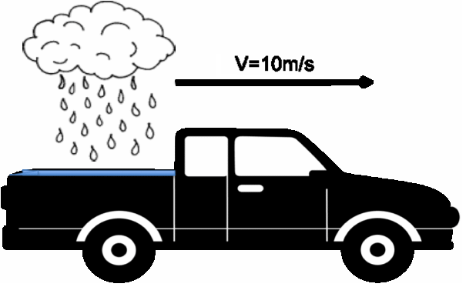
Question Title
Momentum Problems III continued
Question Title
The rain begins accumulating again in the water-tight bed of the pick up truck.

Slide 13
Question Title
Momentum Problems III continued
Question Title
What effect will the accumulating water have on the momentum and kinetic energy of the truck?
You can assume that the road you are driving on has negligible friction and that you can ignore the effect of the rain droplets hitting the front of the vehicle.
The momentum of the truck increases, and the kinetic energy of the truck does not change.
The momentum of the truck does not change , and the kinetic energy of the truck decreases.
The momentum of the truck decreases, and the kinetic energy of the truck decreases.
The momentum of the truck does not change, and the kinetic energy of the truck does not change.
The momentum of the truck increases, and the kinetic energy of the truck increases.

Slide 14
Question Title
Solution
Question Title
Answer: B
Justification: The question describes a truck rolling along with an initial velocity of 10 m/s with a steadily increasing mass. Similarly to the last question we are going to need remember how momentum and kinetic energy depend on mass and relate to one another:
1) p = m×v 2) E_{K} = ½mv²
Unlike the last question, momentum is going to be conserved since there is no net external force acting on the system (i.e. the truck). This is because last time the Cruise Control setting meant that the truck maintained a constant speed even though its mass increased, whereas in this case the engine has cut out and cannot impart any force on the truck. With this bit of information we can immediately disregard any answer that suggests the momentum changes.

Slide 15
Question Title
Solution continued
Question Title
For the sake of clarity lets imagine that the mass of the truck doubles due to the accumulating rain. Although this is not realistic it will make the math easier to understand and the results will hold for any smaller increase in the mass of the truck.
If the mass of the truck doubles we can use the conservation of momentum to figure out the change in the truck’s velocity:
Momentum before: Momentum after:
Since momentum is conserved:
Therefore:
Thus we can see that in this case, the velocity of the truck will be reduced by half.

Slide 16
Question Title
Solution continued
Question Title
Now let us look at how these changes will impact the kinetic energy of the system.
Kinetic energy before: Kinetic energy after:
Thus we can see that the final kinetic energy is less than the initial kinetic energy by a factor of ½ (the amount here is not important, it is more important to see that the kinetic energy of the truck decreases).
Therefore the momentum of the system will remain constant while the kinetic energy of the system will decrease (answer B).

Slide 17
Question Title
Momentum Problems IV
Question Title
Andrew is driving his 2000 kg car at 50 km/h. He diverts his attention from the road to text a friend and drives into the back end of the car in front of him, moving them both at a speed of 40 km/h. If the second car has a mass of 1000 kg, how fast was it travelling prior to the collision?
0 km/h
10 km/h
20 km/h
30 km/h
40 km/h

Slide 18
Question Title
Solution
Question Title
Answer: C
Justification: The principle of the conservation of momentum requires that the momentum of the system (the two cars together) before the collision be equivalent to the momentum of the system after the collision.
The momentum of Andrew's car before the collision is:
The momentum of the second car before the collision is:
Therefore the total momentum of the cars before the collision is:

Slide 19
Question Title
Solution continued
Question Title
After the collision, the two cars are joined, therefore the total momentum of the two cars after the collision is:
Conservation of momentum requires that:
Therefore the second car was initially driving at 20 km/h (answer C).

Slide 20
Question Title
Momentum Problems V
Question Title
When the momentum of an object doubles and its mass remains constant, its kinetic energy:

Slide 21
Question Title
Solution
Question Title
Answer: C
Justification: Momentum of an object is defined as the product of its mass and its velocity:
If the momentum is doubled while the mass remains constant then the velocity must be doubled:
The kinetic energy of an object is defined by the formula:
Substituting the new velocity, 2v, into this equation:
Therefore, by doubling the momentum of an object we quadruple its kinetic energy (answer C).

Slide 22
Question Title
Momentum Problems VI
Question Title
If the system pictured below is an isolated system and has an initial momentum of zero, what can be said about the initial kinetic energy (E_{K}) of the system?
Note that M_{A} and M_{B} are the masses of Block A and B respectively. Similarly, V_{A} and V_{B} are the velocities of Block A and B respectively.
E_{K} > 0 J
E_{K} < 0 J
E_{K} ≥ 0 J
E_{K} = 0 J
E_{K} ≤ 0 J

Slide 23
Question Title
Solution
Question Title
Answer: C
Justification: To assess this question it is important to understand that momentum is a vector quantity and kinetic energy is a scalar quantity. Since the initial momentum of the system is zero this means that the sum of the momentum vectors is zero. This can happen when:
the momentum of block A and block B are in equal and opposite directions or
the momentum of each block is zero, which occurs when V_{A} = V_{B} = 0 m/s.
The corresponding kinetic energies to each situation are as follows:
E_{K} > 0 J since E_{k} = ½mv² and each of the blocks has a velocity that is non-zero
E_{K} = 0 J since E_{k} = ½mv² and both of the blocks have a velocity of zero

Slide 24
Question Title
Solution continued
Question Title
Therefore, by putting the two possible options together, we get the answer of E_{K} ≥ 0 J (answer C).
It is important to note that answers B and E could never be true, since the kinetic energy of a system can never be less than zero.

Slide 25
Question Title
Momentum Problems VII
Question Title
The system pictured below is an isolated system and it is known that the kinetic energy of Block B is four times that of Block A.
Note that M_{A} and M_{B} are the masses of Block A and B respectively.
Similarly, V_{A} and V_{B} are the velocities of Block A and B respectively.

Slide 26
Question Title
Momentum Problems VII continued
Question Title
Which of the following statements is true?
Choose the best answer.
|V_{A}| = |V_{B}| and M_{A} = 4M_{B}
|V_{A}| = |V_{B}| and 4M_{A} = M_{B}
|2V_{A}| = |V_{B}| and M_{A} = M_{B}
|V_{A}| = |2V_{B}| and M_{A} = M_{B}
i, iii
ii, iii
i, iv
ii, iv
ii only

Slide 27
Question Title
Solution
Question Title
Answer: B
Justification: To figure out this question you need to know that
E_{K} = ½mv²
Since the question says "the kinetic energy of Block B is four times that of Block A" this means we can write:
4E_{KA} = E_{KB} where the A and B represent blocks A and B respectively
Now we can assess each of the scenarios (i to iv) using the formula for kinetic energy of each block:
E_{KA} = ½M_{A}V_{A}² and E_{KB} = ½M_{B}V_{B}²
To assess each scenario we need to substitute the values provided into one of the two equations above so that we have both equations written in terms of V_{A} and M_{A} OR V_{B} and M_{B}. Once we have done this we can check to see if the equality 4E_{KA} = E_{KB} holds up in each situation.

Slide 28
Question Title
Solution continued
Question Title
|V_{A}| = |V_{B}| and M_{A} = 4M_{B}
E_{KA} = ½M_{A}V_{A}² = ½(4M_{B})V_{B}² = 4(½M_{B}V_{B}²) = 4E_{KB}
This equality is the opposite of what is required (in this case the kinetic energy of block A is four times that of B), therefore (i) is incorrect.
|V_{A}| = |V_{B}| and 4M_{A} = M_{B}
E_{KB} = ½M_{B}V_{B}² = ½M_{A}V_{A}² = 4(½M_{A}V_{A}²) = 4E_{KA}
In this case we get the correct equality, therefore (ii) is correct.

Slide 29
Question Title
Solution continued
Question Title
|2V_{A}| = |V_{B}| and M_{A} = M_{B}
E_{KB} = ½M_{B}V_{B}² = ½M_{A}(2V_{A})² = ½M_{A}(4V_{A}²) = 4(½M_{A}V_{A}²) = 4E_{KA}
In this case we get the correct equality, therefore (iii) is correct.
|V_{A}| = |2V_{B}| and M_{A} = M_{B}
E_{KA} = ½M_{A}V_{A}² = ½M_{B}(2V_{B})² = ½M_{B}(4V_{B}²) = 4(½M_{B}V_{B}²) = 4E_{KB}
This equality is the opposite of what is required (in this case the kinetic energy of block A is four times that of B), therefore (iv) is incorrect.
The correct answers were (ii) and (iii), therefore the answer is B.

Slide 30
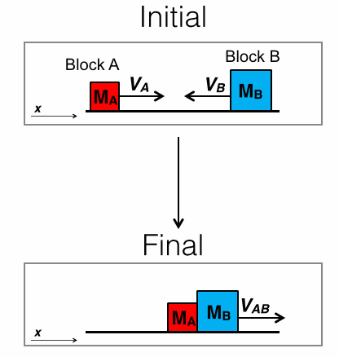
Question Title
Momentum Problems VIII
Question Title
Consider the isolated system shown to the right. When Blocks A and B collide it is an inelastic collision where momentum is conserved, but some kinetic energy is converted to sound and heat upon the collision. The moment when the two blocks collide the velocity of Block B is ½V in the direction shown in the "Initial" diagram. After the collision the velocity of the two blocks "stuck together" is 2V in the direction shown in the "Final" diagram. The positive direction is indicated by the x arrow.

Slide 31
Question Title
Momentum Problems VIII continued
Question Title
If the mass of block B is two times the mass of Block A, what must the velocity of Block A be?
Note: M_{A} and M_{B} are the masses of Block A and B respectively. Similarly, V_{A} and V_{B} are the velocities of Block A and B respectively. M_{AB} is the combined mass after the collision and V_{AB} is the velocity of this mass after the collision.

Slide 32
Question Title
Solution
Question Title
Answer: A
Justification: First of all, since this is an inelastic collision, we know that kinetic energy is not conserved. Therefore we cannot use conservation of kinetic energy to solve this problem. However, we can use the conservation of momentum.
To begin, we need to write down all of the information that has been provided in the text of the question. We need to keep in mind the positive x direction as indicated in the question.
Initially we know:
V_{B} = – ½V
M_{B} = 2M_{A}
V_{A} = ?
Finally we know:
V_{AB} = 2V
M_{AB} = M_{A} + M_{B} = M_{A} + 2M_{A} = 3M_{A}

Slide 33
Question Title
Solution continued
Question Title
Since momentum is conserved this means that the momentum of the system in the initial and final diagrams must be equal to one another. Using this information in combination with the equation for momentum, p = mv, and keeping in mind that momentum is a vector quantity we can say:
p_{i} = p_{f}
p_{A} + p_{B} = p_{AB}
M_{A}V_{A} + M_{B}V_{B} = M_{AB}V_{AB}
M_{A}V_{A} + (2M_{A})(– ½V) = (3M_{A})(2V)
Cancel out all M_{A}'s because they are in all terms and simplify:
V_{A} – V = 6V
Therefore V_{A} = 7V (answer A)

Slide 34
Question Title
Momentum Problems IX
Question Title
A baseball (1 kg) coming from the East is approaching Barry at 10 m/s. Barry hits the baseball back to where it came from and the baseball leaves his bat at 10 m/s. What is the impulse Barry delivered to the baseball?
0 N.s to the East
0 N.s to the West
10 N.s to the East
20 N.s to the East
20 N.s to the West

Slide 35
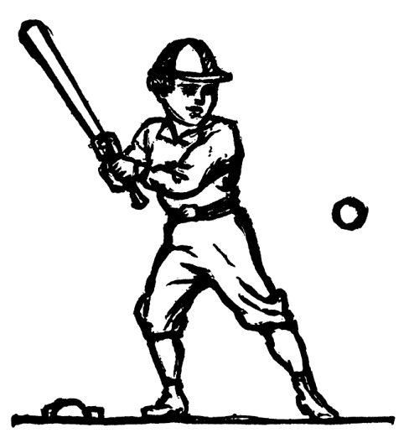
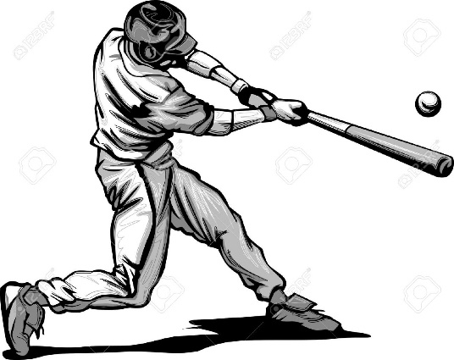
Question Title
Solution
Question Title
Answer: D
Justification: In a collision, an object experiences a force for a specific amount of time that results in a change in momentum. The result of the force acting for the given amount of time is that the object's mass either speeds up or slows down (or changes direction). The impulse experienced by the object equals the change in momentum of the object. To answer this question, let us first draw a diagram:
Before
After
West
East
10 m/s
10 m/s

Slide 36
Question Title
Solution continued
Question Title
The ball is coming from the East, therefore it must be heading West. If we take East as the positive direction, we have:
Since the final answer is positive, the change in momentum must be directed towards the East. Therefore the answer is 20 N.s to the East (answer D).

Slide 37
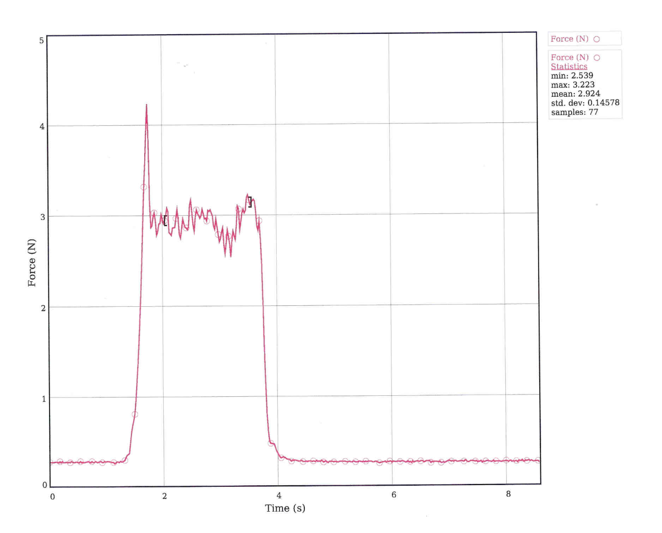
Question Title
Momentum Problems X
Question Title
Below is a graph of the impulse experienced by a driver without his seat belt and air bag during a car crash.

Slide 38
Question Title
Momentum Problems X continued
Question Title
What is NOT true if he was wearing his seat beat and his air bag was working?
The maximum force would be lower
The graph would be more spread out
The area under the graph would be less
The peak of the graph may be slightly shifted

Slide 39
Question Title
Solution
Question Title
Answer: C
Justification: Impulse can be delivered in one big force for a short duration or distributed over a longer time frame at a lower force. We can see this in one of the equations used to define impulse:
Impulse = Force × Time
We can now analyze each answer. Remember that we are looking for the answer which is NOT true:
A) Both the air bag and the seat belt would help dampen the crash for the driver. They would distribute the force of the crash over a longer period of time, and therefore the maximum force experienced by the driver would be decreased. Therefore this answer is true.

Slide 40
Question Title
Solution continued
Question Title
B) The air bag and the seat belt would dampen the force and spread this out over a longer period of time. Since the graph is one of Force vs. Time, if the time is increased, the graph would be more spread out. Therefore this answer is true.
C) Since we are dealing with the same collision, we know that the total change in momentum should be the same for both the situation with and without a seatbelt and airbag. Therefore the impulse delivered is the same. Since the area of the graph is Force × Time = Impulse, the area should not be lower. Therefore this answer is not true, and is the answer we are looking for.
D) That the peak "MAY" be shifted doesn't necessarily mean it will, in some cases it will. As the graph spreads out, the peak may be slightly shifted. It will depend on the design of the seatbelt and airbag, and how exactly they spread out the force of the impact. See the next page for some examples of how the force can be distributed over time.

Slide 41
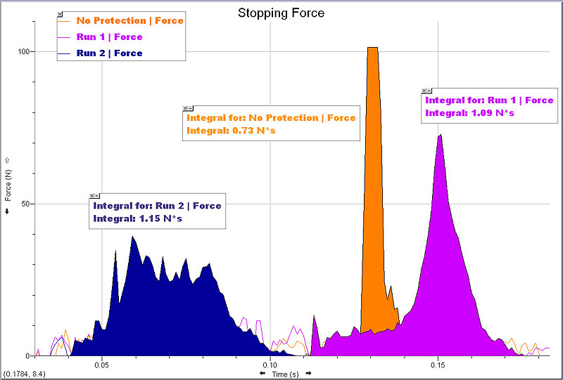
Question Title
Solution continued 2
Question Title

