Slide 1
Physics Thermodynamics
FACULTY OF EDUCATION
Department of
Curriculum and Pedagogy
Science and Mathematics Education Research Group
Supported by UBC Teaching and Learning Enhancement Fund 2012-2015
Notes:
Categories: Secondary – Physics – Thermodynamics
Tags: thermodynamics, pressure, volume, temperature, gas constant, conduction, convection, radiation, evaporation,
Excerpt: This physics problem set tests your knowledge on thermodynamics problems

Slide 2
Question Title
Thermodynamics
Question Title
Retrieved from http://www.apologeticspress.org/apcontent.aspx?category=12&article=2786

Slide 3
Question Title
Thermodynamics
Question Title
The following questions have been compiled from a collection of questions submitted on PeerWise (https://peerwise.cs.auckland.ac.nz/) by teacher candidates as part of the EDCP 357 physics methods courses at UBC.

Slide 4
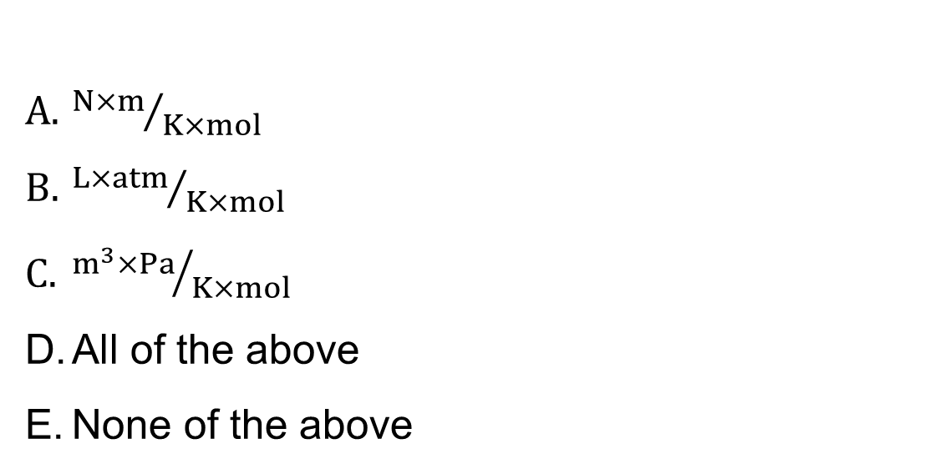
Question Title
Thermodynamics I
Question Title
The Gas Constant has which of the following units?
*Hint* Recall PV=nRT. R is the Gas Constant

Slide 5
Question Title
Solution
Question Title

Slide 6
Question Title
Solution continued
Question Title

Slide 7
Question Title
Solution continued 2
Question Title

Slide 8
Question Title
Thermodynamics II
Question Title
Which of the following statements is TRUE?
Conduction is the transfer of heat between particles that are in direct contact
Conduction causes a vibration of the particles which is visible (i.e. can be seen)
Conduction produces a continuous circulation pattern
Conduction does not rely upon any contact between the heat source and the heated object
Heat released from the filament of a light bulb is an example of conduction

Slide 9
Question Title
Solution
Question Title
Answer: A
Justification: If there is a temperature difference between two systems heat will always find a way to transfer from the higher to lower system.
Heat can travel from one place to another in three ways: Conduction, Convection and Radiation.
Conduction: is the transfer of heat between substances that are in direct contact with each other. The better the conductor, the more rapidly heat will be transferred (for example metal is a good conductor of heat).
When a substance is heated, particles will gain more energy, and vibrate more. These molecules then bump into nearby particles and transfer some of their energy to them. This then continues and passes the energy from the hot end down to the colder end of the substance.

Slide 10
Question Title
Solution continued
Question Title
Convection: occurs when warmer areas of a liquid or gas rise to cooler areas in the liquid or gas. Cooler liquid or gas then takes the place of the warmer areas which have risen higher. This results in a continuous circulation pattern. Water boiling in a pan is a good example of these convection currents. Another good example of convection is in the atmosphere: The earth's surface is warmed by the sun, the warm air rises and cool air moves in.
Radiation: is a method of heat transfer that does not rely upon any contact between the heat source and the heated object (as is the case with conduction and convection). Heat can be transmitted though empty space. No mass is exchanged and no medium is required in the process of radiation. Examples of radiation are the heat from the sun, or heat released from the filament of a light bulb.

Slide 11
Question Title
Solution continued 2
Question Title
Given the previous definitions:
True, conduction happens when particles are in direct contact, and the hotter particles vibrate more and transfer their energy to the particles with which they are in contact.
False, while the vibration is happening at a molecular level the movement cannot be observed visually. However, if you were to heat one end of a metal rod you would be able to observe conduction by feeling the heat at the cooler end as it conducts through.
False, convection (not conduction) is the heat transfer method that produces a continuous circulation pattern, as defined previously.
False, radiation (not conduction) is the heat transfer method that does not rely on direct contact between the heat source and the heated object, as defined previously.
False, heat released by the filament of a light bulb is an example of radiation, not conduction.

Slide 12
Question Title
Thermodynamics III
Question Title
What temperature has the same value in both the Centigrade and Fahrenheit scales?
20 degrees C = 20 degrees F
30 degrees C = 30 degrees F
40 degrees C = 40 degrees F
50 degrees C = 50 degrees F
The values are never the same

Slide 13
Question Title
Solution
Question Title
Answer: C
Justification:
Use the relationship between Fahrenheit and Celsius:
T(°F) = 1.8 × T(°C) + 32
You're looking for the temperature where T(°F) = T(°C).
Replace both temperatures with "T" in the equation above and just solve for T:
T = 1.8T + 32
-0.8T = 32
T= -32/0.8
T = -40

Slide 14
Question Title
Solution continued
Question Title
So, at -40° the temperature of the Celsius (Centigrade) and Fahrenheit scales are equal, therefore our answer is C.
We can see from this answer that:
At temperatures warmer than -40° Fahrenheit the Centigrade scale values are always lower (e.g. -20° F = -29° C and 50° F = 10° C).
However, at temperatures colder than -40° F the Centigrade scale values are higher (e.g. -50° F = -45.5° C and -130° F = -90° C).

Slide 15
Question Title
Thermodynamics IV
Question Title
Some liquid is contained in a dish that is open to the atmosphere. The rate of evaporation of the liquid depends on:
I. the temperature of the liquid.
II. the temperature of the atmosphere.
III. the depth of the liquid.
IV. the pressure of the atmosphere.
I & II
I & III
I, II, & III
I, II, & IV
All of the above
Pick the best possible answer!

Slide 16
Question Title
Solution
Question Title
Answer: D
Justification: Of the four options, I, II and IV affect the rate of evaporation of a liquid.
I. The temperature of the liquid affects how quickly a liquid will evaporate, for example if its temperature is below its boiling point it will not evaporate very quickly as very few molecules will have enough energy to break free from the liquid.
II. The temperature of the atmosphere affects the rate of evaporation, because if the atmosphere is actually colder than the liquid, the liquid will lose heat to the atmosphere which will not go into boiling the liquid, and if the atmosphere is hotter it will be transferring energy into the liquid which will cause it to evaporate faster.

Slide 17
Question Title
Solution continued
Question Title
III. The depth of the liquid does not affect the rate of evaporation at all. The surface area of a liquid will affect how quickly it will evaporate. More water molecules exposed to the atmosphere (because of a larger surface area) will result in more molecules escaping into the atmosphere. However, it does not matter how many more water molecules there are below the surface.
IV. The pressure of the atmosphere will affect the rate of evaporation, as a higher pressure will raise the boiling point, and a lower pressure will lower the boiling point.
Therefore the answer is D.

Slide 18
Question Title
Thermodynamics V
Question Title
Which of the following does NOT play a role in the rate of evaporation of water?
Surface area of the water.
Depth of the water.
Temperature of the water.
Humidity outside the water.

Slide 19
Question Title
Solution
Question Title
Answer: B
Justification:
Evaporation is a cooling process. It occurs when the molecules in a liquid (which are in a state of continuous motion) escape the surface of a liquid into a gaseous phase. In the middle of the liquid these molecules are always colliding with each other, but on the surface the fastest molecules are able to escape the liquid altogether.
The surface area (A) affects how much of the water is exposed to the air, the greater the surface area, the greater the evaporation.
Note: This question is very similar to the previous question.

Slide 20
Question Title
Solution continued
Question Title
The temperature (C) of the water affects how fast the molecules in the water are moving, and the faster the molecules are moving, the more of them will escape the surface of the water. Therefore the higher the temperature, the higher the rate of evaporation.
The humidity (D) outside the water represents the amount of water vapor in the air. The more water molecules there are in the air, the higher the humidity. At any given temperature, there is a maximum amount of water vapor that air can hold (higher temperature air can hold more water vapor). When this maximum saturation point is reached, condensation occurs. The humidity also affects the evaporation rate of water, as a higher humidity means that there are more water molecules in the air that can collide with the water molecules trying to escape the surface of the water. Therefore a higher humidity will result in a lower rate of evaporation.

Slide 21
Question Title
Solution continued 2
Question Title
The depth (B) of the water does not affect the rate of evaporation. It does not matter how many molecules are under the surface of the water, only the surface area is the most important. This is why people use shallow, wide ponds to evaporate seawater for salt extraction, and why dams are designed to have small surface areas to prevent evaporation.
We can see from all the previous explanations that the answer is B.

