Slide 1
Physics Wave Problems
FACULTY OF EDUCATION
Department of
Curriculum and Pedagogy
Science and Mathematics Education Research Group
Supported by UBC Teaching and Learning Enhancement Fund 2012-2015
Notes:
Categories: Secondary – Physics – Waves
Tags: waves, vellocity, wavelength, frequency, period, displacement
Excerpt: This physics problem set tests your knowledge on waves through different problems

Slide 2
Question Title
Wave Problems
Question Title
Retrieved from: http://wallpaper4god.com/en/background_water-waves/

Slide 3
Question Title
Wave Problems
Question Title
The following questions have been compiled from a collection of questions submitted on PeerWise (https://peerwise.cs.auckland.ac.nz/) by teacher candidates as part of the EDCP 357 physics methods courses at UBC.

Slide 4
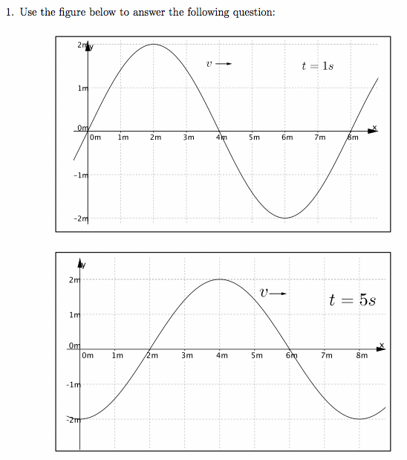
Question Title
Wave Problems I
Question Title
Use the two figures below to answer the question on the following page:

Slide 5
Question Title
Wave Problems I continued
Question Title
What is a possible velocity of the wave? Choose the best answer.
i & iii
ii
iii
iv
ii & iv

Slide 6
Question Title
Solution
Question Title
Answer: A
Justification: To begin with, we can look at the definition of velocity.
Velocity is the change in distance over time:
We can use the graphs to figure out ∆x and ∆t.
∆x is the distance the wave moves, therefore if we look at the x position of the crest of the wave at t = 1 s and t = 5 s, we can see that ∆x = 2 m. From the graphs we can see that these were snapshots taken at t = 1 s and t = 5 s, therefore ∆t = 4 s. Using the equation for velocity we get:
Therefore (iii) is a correct option.

Slide 7
Question Title
Solution continued
Question Title
However, the question has not specified how many wavelengths have passed by in this time period.
This means that ∆x could be equal to ∆x + nλ, where λ is the wavelength of the wave (8 m) and n is an integer.
Therefore in our initial calculation, we assumed that the wave only moved 2 m (i.e. not even one wavelength passed in that time).
Therefore ∆x_{n} = ∆x + nλ = 2 + (0)(8) = 2 m (which is what we got initially)
However, if one wavelength passed during this time, then:
∆x_{n} = ∆x + nλ = 2 + (1)(8) = 10 m
Therefore:
Therefore (i) is also a correct option.

Slide 8
Question Title
Solution continued 2
Question Title
We can see that all of our answers (no matter how large n gets) will be divided by two. Therefore we can conclude that options (ii) and (iv) are incorrect.
Therefore the final answer is A.

Slide 9
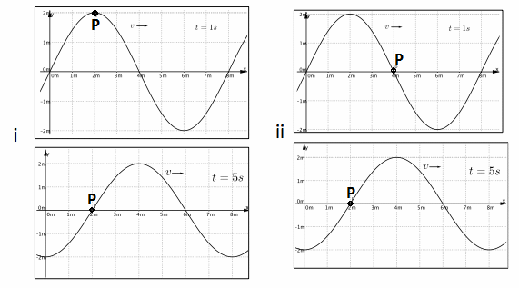
Question Title
Wave Problems II
Question Title
If point P represents a single particle in the medium that the wave is moving through, which pair(s) of graphs show the correct position of P at the two points in time? Choose the best answer.

Slide 10
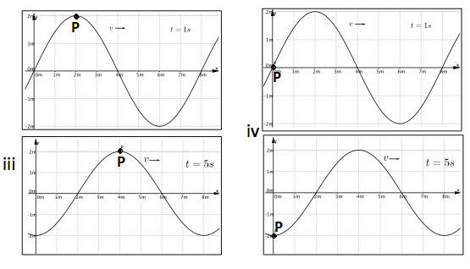
Question Title
Wave Problems II continued
Question Title
i
iii
i & iv
ii & iii
ii

Slide 11
Question Title
Solution
Question Title
Answer: C
Justification: Here it is important to understand that we are looking at one particle and the only motion it has is in the vertical direction. This is because as the wave moves through the medium, the particles within the medium do not move along with the wave. Even though the wave propagates forward (in the y-direction), the particles within the medium only move up and down (in the x–direction). Therefore as the wave propagates through the medium only the graphs with the point P in the same x position are correct.
Therefore (i) and (iv) are correct (answer C).

Slide 12
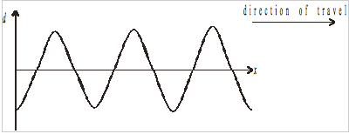
Question Title
Wave Problems III
Question Title
The diagram below shows the variation with distance x along a wave with its displacement d. The wave is travelling in the direction shown.

Slide 13
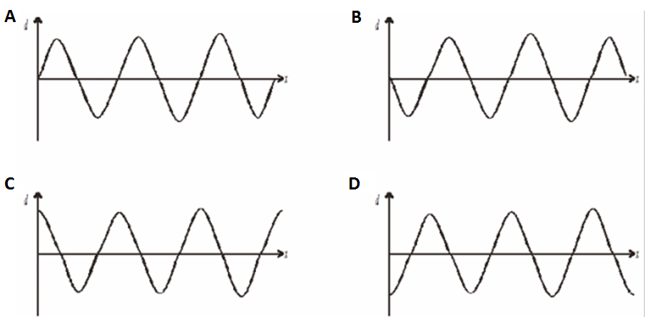
Question Title
Wave Problems III continued
Question Title
The period of the wave is T. Which of the following diagrams most accurately represents the wave a time T/4 later?

Slide 14
Question Title
Solution
Question Title
Answer: B
Justification: The period is the time it takes for a cycle to repeat itself, meaning the time from one peak to the next. Each period can be divided into 4 sections, marked by specific moments:
1) The moment when the displacement is at its peak marks the beginning of its period (this is just a moment we have chosen – you could easily pick any point in this cycle to start with, provided it goes through one complete cycle).
1

Slide 15
Question Title
Solution continued
Question Title
2)The moment when the displacement is decreasing and reaches zero.
1
2
3)The moment when the displacement has reached its lowest point. The magnitude of this value will be equal to the value at its highest point, barring any damping of the wave.
1
2
3

Slide 16
Question Title
Solution continued 2
Question Title
4)The moment when the displacement is increasing and reaches zero.
1
2
3
4
And the moment when the displacement has reached its peak again, completing one period.
1
2
3
4
1
New period starts over again

Slide 17
Question Title
Solution continued 2
Question Title
Thus, looking at the initial graph, the point in the cycle when the wave is at the d-axis is when the displacement of the wave is at its lowest point (section 3 in the cycle).
3
4
1
2
Initial position of wave on d-axis
One quarter of a cycle (T/4) later would mean the displacement of the wave would be zero, and would be increasing (section 2 in the cycle). Remember here that the wave is moving along the x-axis to the right.
2
3
4
1
Direction of wave
2
T/4 time later, each section moves over one in the direction of the movement of the wave
Therefore the answer is B.

Slide 18
Question Title
Wave Problems IV
Question Title
Two identical triangular pulses of amplitude X travel toward each other along a string. At the instant shown on the diagram below, point M is midway between the crests of the two pulses.
M
What is the amplitude of the disturbance in the string as the pulses move through point M?
2X
X
X/2
0

Slide 19
Question Title
Solution
Question Title
Answer: D
Justification: When two waves are travelling through the same space, they are added together. The net amplitude is the sum of the amplitudes of both waves.
Since the pulses are identical except for the direction of their displacement, (one being in an upward direction we might as well call positive, and the other being in a downwards direction which we can call negative) when the two pulses meet, they will cancel each other out.
Thus, D is the correct answer.

