Slide 1
Physics Buoyancy
FACULTY OF EDUCATION
Department of
Curriculum and Pedagogy
Science and Mathematics Education Research Group
Supported by UBC Teaching and Learning Enhancement Fund 2012-2015
Notes:
Categories: Secondary – Physics – Buoyancy
Tags: Secondary, Physics, Buoyancy
Excerpt: Explore how buoyant force on any submerged object is related to the weight of the water displaced.

Slide 2
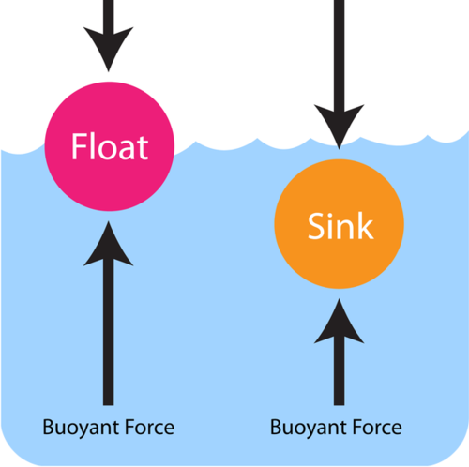
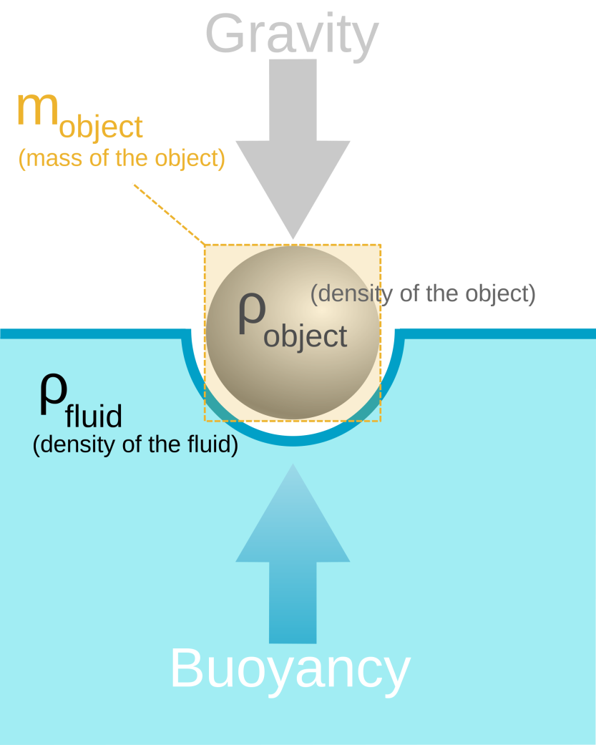
Question Title
Buoyancy
Question Title
https://www.pinterest.com/pin/185843922097748700/
https://en.wikipedia.org/wiki/Buoyancy

Slide 3
Question Title
Buoyancy
Question Title
The following questions have been compiled from a collection of questions submitted on PeerWise (https://peerwise.cs.auckland.ac.nz/) by teacher candidates as part of the EDCP 357 physics methods courses at UBC.

Slide 4
Question Title
Buoyancy Problems I
Question Title
A completely submerged block of ice is tethered to the bottom of the container, as shown below. What will happen to the water level when the block of ice melts?
ice block
Water level will rise.
Water level will drop.
Water level will remain the same
water

Slide 5
Question Title
Solution
Question Title
Answer: B
Justification: Have you noticed that ice cubes float in water instead of sinking? The fact that ice floats in water suggests that ice is less dense than water, which appears to be counterintuitive. Most materials are denser when they are solid than when they are liquid. As water is cooled down, the water molecules have less energy and hydrogen bonding takes over. As a result, the water molecules form a ordered crystal through hydrogen bonding, which spaces the water molecules farther apart than when they were in a liquid. This makes ice less dense than water, allowing ice to float in water.

Slide 6
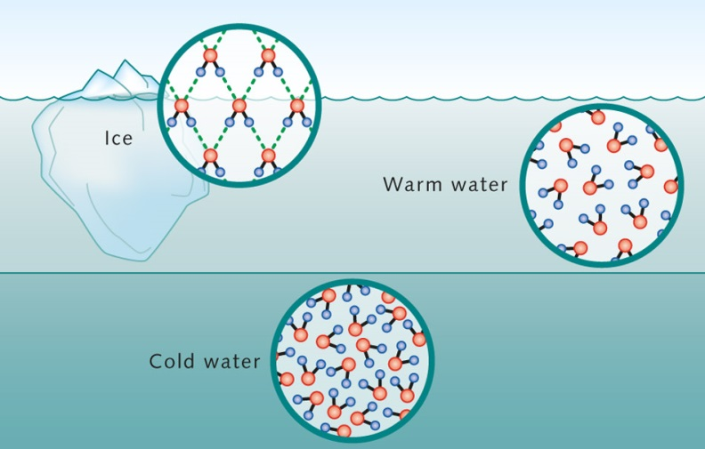
Question Title
Solution continued
Question Title
Answer: B
This means that if we compare the volumes for samples of ice and water of equal mass, the ice would occupy more space. When the ice melts, we have an equivalent mass of water that takes up less space and the result is a lowered water level.
Therefore, B is the correct answer.
Watch: https://www.youtube.com/watch?v=UukRgqzk-KE

Slide 7
Question Title
Buoyancy Problems II
Question Title
Suppose a basketball, with a mass of 100 grams and a volume of 4 liters, tethered to a bag is maintaining a neutral buoyancy in water. If the mass of the bag is 8 kilograms, what is the buoyancy of the bag?
basketball (100g, 4L)
121 N
80 N
41 N
40 N
39 N
water
bag (8 kg)

Slide 8
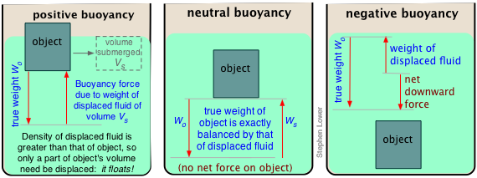
Question Title
Solution
Question Title
Answer: C
Justification: Buoyancy is an upward force exerted by a liquid that opposes the weight of an immersed object. Neutral buoyancy is a condition in which the buoyancy is equal to the weight of an immersed object.
http://chemwiki.ucdavis.edu/Physical_Chemistry/Physical_Properties_of_Matter/Bulk_Properties/Density/Buoyancy

Slide 9
Question Title
Solution continued
Question Title
Answer: C
Note that the basketball displaces 4 litres of water, so there is an upward force of $4 kg ×10\frac{m}{s^{2}}=40 N$. But the mass of the basketball produces a downward force of $0.1 kg ×10\frac{m}{s^{2}}=1 N$. Therefore, the net buoyancy force (upward direction) acting on the basketball is $40 N −1 N=39 N$. Now, the bag has a mass of $8 kg$, which causes a downward force of $8 kg ×10\frac{m}{s^{2}}=80 N$. In order to maintain neutral buoyancy, there must be a net force of zero on the system. Therefore the bag must contribute a buoyant force of $80 N −39 N=41 N$ (upwards).
Therefore, C is the correct answer.
Watch: https://www.youtube.com/watch?v=nMlXU97E-uQ

Slide 10
Question Title
Solution continued
Question Title
Here is a simplified diagram to illustrate the balance of the forces:
Total buoyant force = 81 N
Total force of gravity = 81 N
Buoyant force on basketball = 40 N
Force of gravity on basketball = 1 N
Buoyant force on bag = 41 N
Force of gravity on bag = 80 N
Net force = 0 N

Slide 11
Question Title
Buoyancy Problems III
Question Title
Suppose a basketball, with a mass of 100 grams and a volume of 4 liters, tethered to a bag is maintaining a neutral buoyancy in water. If the basketball deforms by 10% (reduces volume) and the bag has a buoyant force of 30 N, what is the mass of the bag?
basketball (100g)
7.0 kg
6.9 kg
6.5 kg
6.1 kg
6.0 kg
water
10% less volume
bag (x kg)

Slide 12
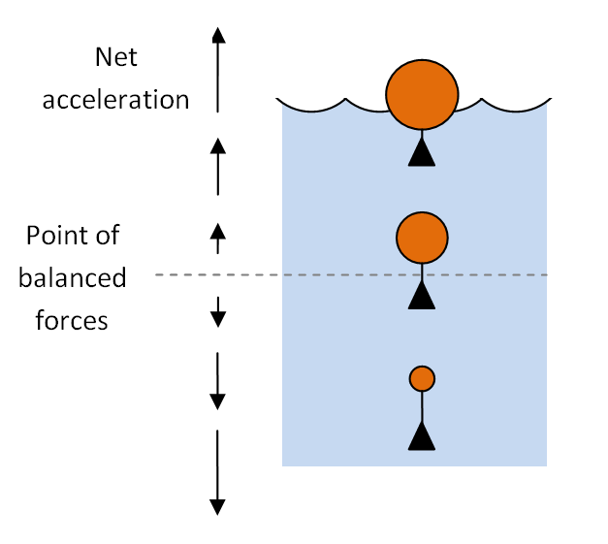
Question Title
Solution
Question Title
Answer: C
Justification: Buoyancy is an upward force exerted by a liquid that opposes the weight of an immersed object. Neutral buoyancy is a condition in which the buoyancy is equal to the weight of an immersed object.
Note that the basketball displaces $4 L ×90\%=3.6 L$ of water, so there is an upward force of $3.6 kg ×10\frac{m}{s^{2}}=36N$.

Slide 13
Question Title
Solution continued
Question Title
Answer: C
But the mass of the basketball produces a downward force of $0.1 kg ×10\frac{m}{s^{2}}=1 N$. Therefore, the net buoyancy force acting on the basketball is $36 N −1 N=35 N$. Also the bag contributes a buoyant force of $30 N$. Note that the combined buoyant force is now $65 N$. In order to maintain neutral buoyancy, the weight of the bag must be $65 N$. Thus, the mass of the bag is $\frac{65N}{10 m/s^{2}}=6.5 kg$.
Therefore, C is the correct answer.
Watch: https://www.youtube.com/watch?v=nMlXU97E-uQ

Slide 14
Question Title
Solution continued
Question Title
Answer: C
But the mass of the basketball produces a downward force of $0.1 kg ×10\frac{m}{s^{2}}=1 N$. Therefore, the net buoyancy force acting on the basketball is $36 N −1 N=35 N$ (upwards). Also, the bag contributes an upwards buoyant force of $30 N$. Note that the combined buoyant force is now $65 N$ (upwards). In order to maintain neutral buoyancy, the weight of the bag (the force of gravity downwards) must be $65 N$. Thus, the mass of the bag is $\frac{65N}{10 m/s^{2}}=6.5 kg$.
Therefore, C is the correct answer.
Watch: https://www.youtube.com/watch?v=nMlXU97E-uQ

