Slide 1
Physics Circular Motion Problems
FACULTY OF EDUCATION
Department of
Curriculum and Pedagogy
Science and Mathematics Education Research Group
Supported by UBC Teaching and Learning Enhancement Fund 2012-2015
Notes:
Categories: Secondary – Physics – Circular Motion
Tags: circular motion, radial acceleration, velocity, gravity, energy
Excerpt: Many different physics problems that have to do with circular motion

Slide 2
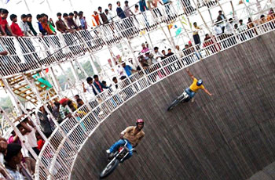
Question Title
Circular Motion Problems
Question Title
Retrieved from: http://www.wonderwhizkids.com/index.php/physics/mechanics/circular-motion

Slide 3
Question Title
Circular Motion Problems
Question Title
The following questions have been compiled from a collection of questions submitted on PeerWise (https://peerwise.cs.auckland.ac.nz/) by teacher candidates as part of the EDCP 357 physics methods courses at UBC.

Slide 4
Question Title
Circular Motion Problems I
Question Title
A Ferrari is traveling in a uniform circular motion around a racetrack. What happens to the radial acceleration of the car if the velocity is doubled and the radius of the circle is halved?
It remains the same.
It increases by a factor of 2.
It increases by a factor of 4.
It increases by a factor of 8.
It decreases by a factor of 2.

Slide 5
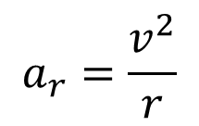
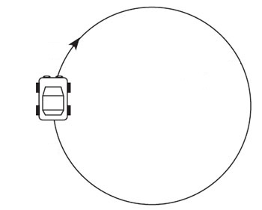
Question Title
Solution
Question Title
Answer: D
Justification: The radial acceleration for a car in a uniform circular motion is:
v is the velocity of the car and r is the radius of the circular track
v
r

Slide 6
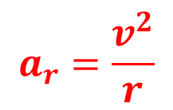
Question Title
Solution continued
Question Title
If we double the velocity, we can see that the radial acceleration, a_{r} will be increased by a factor of 4 (velocity is squared).
If we halve the radius (i.e. multiply it by ½), then since it is inversely proportional to a_{r}, the radial acceleration will increase by a factor of 2 (it will double).
Therefore, a_{r} is increased by a factor of 2 x 4 = 8 (answer D).
Note: If you are driving and you approach a curve, it is important to slow down because your acceleration increases by a factor of velocity squared. The sharper the curve is (the smaller the radius of circular motion), the more acceleration you will need to be able to turn. This acceleration is caused by the force of friction between the tires and the road. The friction force keeps the car going along the curved road. Thus, when it is raining (and the force of friction is decreased), remember to slow down while turning.

Slide 7
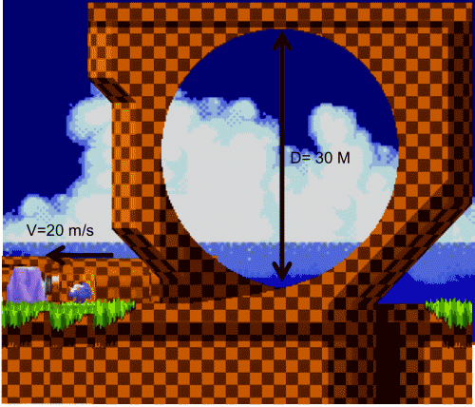
Question Title
Circular Motion Problems II
Question Title
Sonic is rolling towards a spring in order to quickly change the direction of his speed and make it around the loop. The mass of the giant blue hedgehog is 30 kg and he is rolling towards the spring at 20 m/s. The spring is massless (and therefore perfect), can compress 0.5 m and is attached to an immovable block.

Slide 8
Question Title
Circular Motion Problems II continued
Question Title
You can assume that there is no friction between the ground and rolling Sonic.
What is the smallest the spring constant could be in order for Sonic to roll around the 30 m loop?
Remember: Treat Sonic like an indestructible point mass sliding along his trajectory. Acceleration due to gravity = 9.82 m/s².
Sonic already has enough kinetic energy to complete the loop therefore the value of the spring constant is irrelevant.
The value of the minimum spring constant is 71 kN/m.
The value of the minimum spring constant is 88 kN/m.
The value of the minimum spring constant is 119 kN/m.
Sonic cannot make the loop regardless of the spring constant.

Slide 9
Question Title
Solution
Question Title
Answer: C
Justification: This question is solved through the conservation and transfer of energy. How should you know this? The first hint is that we don't have mathematical tools as grade 12's to solve this problem any other way. The second hint is that time is not directly referenced in the problem. The third hint is that Sonic's velocity is the only factor that will determine whether he successfully makes the loop, and since his mass isn't changing, the velocity is only dependent on his kinetic energy.
The first thing that comes to mind when faced with this problem should be:
"What conditions must be met in order for Sonic to make the loop?"

Slide 10
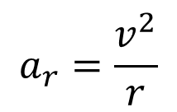
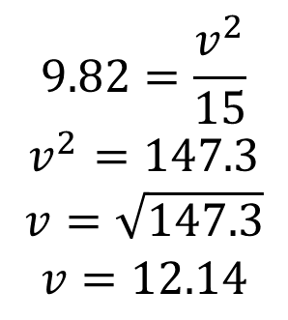
Question Title
Solution continued
Question Title
If we notice that the loop is a case of circular motion we can figure out the minimum velocity required to make the loop by using the formula for radial acceleration:
The radius is half the diameter of 30 m. The minimum acceleration possible (and thus the minimum velocity possible) is the situation when the normal force provided by the loop, and acting on sonic, is zero. In that case the acceleration is only Sonic's acceleration due to gravity and thus we can find our velocity from the following formula:

Slide 11
Question Title
Solution continued 2
Question Title
Now our task is to figure out how the spring constant impacts Sonic’s ability to get to the top of the loop with a velocity of v_{min} = 12.14 m/s
Since Sonic has to change direction on impact with the spring all of Sonic’s energy after impact has to come from the elastic potential energy stored in the spring. Due to energy conservation we then know that the energy stored in the spring (E_{S}) must be equal to the sum of Sonic's potential (E_{P}) and kinetic (E_{K}) energy at the top of the loop. Since we know the height of the loop and the minimum velocity required in order to maintain the circular path we can calculate Sonic's energy at the top of the loop:
Total Energy = E_{k} + E_{P} = ½mv_{min}² + mgh
And since we know the spring can only compress 0.5 m we can use the formula for elastic potential energy of a spring:
E_{S} = ½kx² (where k is the spring constant and x is the amount of compression)

Slide 12
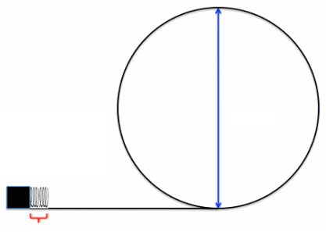
Question Title
Solution continued 3
Question Title
Energy required to follow the circular path:
Total Energy = E_{k} + E_{P} = ½mv_{min}² + mgh
h = 30 m
Possible stored energy:
E_{S} = kx²
In order to make the loop the spring must be able to store the energy required at the height of the loop
L = 0.5 m

Slide 13
Question Title
Solution continued 4
Question Title
Now we can equate the two expressions together to solve for our spring constant:

Slide 14
Question Title
Solution continued 5
Question Title
Notice that we did not need Sonic’s initial velocity to solve this problem. Sonic loses a vast majority of his initial kinetic energy by slamming into the fully compressed spring before being launched in the opposite direction.
Answer A is incorrect because it forgets that the direction of Sonic's motion needs to be changed before his kinetic energy can be used to complete the loop.
Answer B is incorrect because it fails to account for Sonic's kinetic energy at the top of the loop.
Answer D is incorrect because it uses Sonic’s initial velocity to solve for the spring constant k.
Answer E is incorrect due to the indestructible nature of Sonic and his surroundings. Even though Sonic completely compresses the spring and slams to a halt, the stored energy in the spring is still available to him and could propel him around the loop.

Slide 15
Question Title
Circular Motion Problems III
Question Title
You are at Playland enjoying the view from the Westcoast Wheel, their new $1 million Ferris wheel ride.
Using Newton's second law determine where the magnitude of the force the seat exerts on you is:
a) Smallest, so the rider feels the "lightest"
b) Largest, so the rider feels the "heaviest“
a) At the bottom of the Ferris wheel
b) At the top of the Ferris wheel
a) At the top of the Ferris wheel
b) At the bottom of the Ferris wheel
The centripetal acceleration is constant throughout the wheel so the riders feel their "true" weight at all the positions, never lighter or heavier.
There is not enough information given to solve this problem.

Slide 16
Question Title
Solution
Question Title
Answer: B
Justification: This is a 2D kinematics problem involving circular motion. We can start solving the problem by looking at the two different positions of the rider, where position 1 is at the top of the ferris wheel and position 2 is at the bottom of the ferris wheel:
1
We know that in each location the force of gravity F = mg acts on the rider in the downwards direction. We also know that radial acceleration a_{r} is always directed towards the center of the circle, and therefore the force due to radial acceleration (ma_{r}) for position 1 is directed downwards, while for position 2 it is directed upwards. In both cases, m stands for the mass of the rider.
2

Slide 17
Question Title
Solution continued
Question Title
We can use this information to look at the normal force acting on the rider in each position. To do this we can draw two free body diagrams:
Position 1
Position 2
+ve direction
N₁
N₂
a_{r}
a_{r}
mg
mg
Using Newton's second law:
Position 1: N₁ – mg = m (-a_{r}) → N₁ = mg – ma_{r} = m(g – a_{r})
Position 2: N₂ – mg = m(+a_{r}) → N₂ = mg + ma_{r} = m(g + a_{r})

Slide 18
Question Title
Solution continued 2
Question Title
This result shows that N2 > N1, and so the normal force exerted on the rider at the top of the Ferris wheel is the smallest and makes the rider feel the lightest. Conversely, the normal force exerted on the rider at the bottom of the Ferris wheel is the largest and makes the rider feel the heaviest.
Therefore the answer is B.
You should keep in mind that the Ferris wheel moves quite slowly so these sensations may be difficult to distinguish during the ride itself.

Slide 19
Question Title
Circular Motion Problems IV
Question Title
Given your results from the previous question, calculate N₁ and N₂, the normal force exerted on the rider at position 1 (top of the Ferris wheel) and position 2 (bottom of the Ferris wheel).
The diameter of the Westcoast Wheel is 26 m.
The rider weighs 100 kg, acceleration due to gravity is 9.8 m/s².
Hint: You will need to measure the time it takes for the Ferris wheel to complete 1 revolution (for now please use 30 s).
N₁ = 7.5 x 10⁵ N and N₂ = 12.1 x 10⁵ N
N₁ = 750 N and N₂ = 1210 N
N₁ = 9.23 x 10⁵ N and N₂ = 10.37 x 10⁵ N
N₁ = 923 N and N₂ = 1037 N
N₁ = 1037 N and N₂ = 923 N

Slide 20
Question Title
Solution
Question Title
Answer: D
Justification: This question can be answered without any calculations. If we evaluate the options we can see that only D makes sense:
The options given in A & C result from unit conversion errors (using grams instead of kg) and yield enormous numbers which would not be rational.
Option E reverses the information so that the rider feels a greater normal force at the top of the ride, which is contrary to the situation.
Options B & D are the only two "realistic" choices. We are dealing with 980N for the person +/- the force felt at the top or bottom and remember that Ferris wheels usually move quite slowly so it is difficult to feel these changes in forces.
Option B would result in about 25% change in force, which is very unrealistic for a Ferris wheel.
Option D is much more realistic given the conditions of this problem.

Slide 21
Question Title
Solution continued
Question Title
The calculated result is as follows:
We first need to calculate the velocity of the rider as he goes around the Ferris wheel. We can calculate this by finding out the distance of the path the rider travels (the circumference of the circle, 2πr), and divide it by how long it takes the Ferris wheel to complete one revolution (the period, T):
From there, we can calculate the radial acceleration:

Slide 22
Question Title
Solution continued 2
Question Title
From the previous question, we have the equations to calculate the normal force at position 1 and 2:
Therefore the answer is D.
If you used r = 26 m instead of 13 m, you will get option B.

Slide 23
Question Title
Circular Motion Problems V
Question Title
Use your results from the previous question to solve this problem.
How much less/more force do you feel relative to your weight on the ground, at the
1) top of the Ferris wheel (i.e. at position 1)
2) bottom of the Ferris wheel (i.e. at position 2)
1) 94% 2) 106%
1) 106% 2) 94%
1) 76% 2) 124%
1) 124% 2) 76%
There is no change at either position

Slide 24
Question Title
Solution
Question Title
Answer: A
Justification: This question can be answered without any calculations.
We know that the weight will be slightly reduced at the top compared to the bottom (slightly because we know the Ferris wheel is moving very slowly). The only answer that meets this criteria is A.
The option given in C is based on the use of the diameter instead of the radius when solving for acceleration in part 2. It is unrealistic because such a large change in force would be easily felt and this is not the case for a Ferris wheel ride.
Options B & D indicate that the larger force is felt at the top of the ride, which is not the case.
Option E is not valid because, although the change is very slight, there is still some change between the top, middle, and bottom positions on the wheel.

Slide 25
Question Title
Solution continued
Question Title
Calculating the result yields the same conclusion. From Part 2 we determined that:
N₁ = 923 N
N₂ = 1037 N
We can also calculate the rider’s weight on the ground:
F = ma = 100 × 9.8 = 980 N
From this we can calculate the ratios:
N₁/N = 923/980 = 0.94 g at the top of the Ferris wheel, or 94% of his weight
N₂/N = 1037/980 = 1.06 g at the bottom of the Ferris wheel, or 106% of his weight
Therefore the answer is A.

