Slide 1
Physics Electromagnetism Problems
FACULTY OF EDUCATION
Department of
Curriculum and Pedagogy
Science and Mathematics Education Research Group
Supported by UBC Teaching and Learning Enhancement Fund 2012-2015
Notes:
Categories: Secondary – Physics – Electromagnetism
Tags: electromagnetism, magnets, Lenz’s Law
Excerpt: A few physics problems that have to do with electromagnetism

Slide 2
Question Title
Electromagnetism Problems
Question Title
Retrieved from: http://www.nuffieldfoundation.org/practical-physics/electromagnetism

Slide 3
Question Title
Electromagnetism Problems
Question Title
The following questions have been compiled from a collection of questions submitted on PeerWise (https://peerwise.cs.auckland.ac.nz/) by teacher candidates as part of the EDCP 357 physics methods courses at UBC.

Slide 4
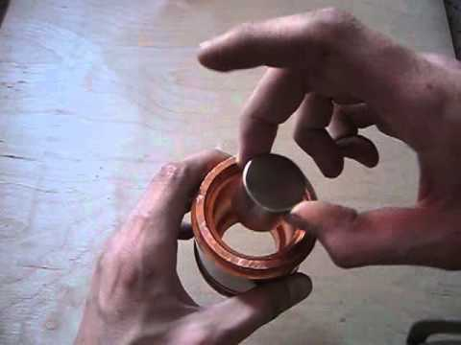
Question Title
Electromagnetism Problems I
Question Title
Here's a video where a magnet is dropped through a copper tube:
Which of the following properties could be changed so that the magnet moves so slowly through the tube that it eventually stops?
Use a stronger magnet that is identical in shape and size as the one in the video.
Increase the length of the copper tube.
Use a copper tube that has a bigger hole.
None of the above.

Slide 5
Question Title
Solution
Question Title
Answer: D
Justification: According to Lenz's Law, an electric current induced by a changing magnetic field (such as a magnet falling down a tube) will flow such that it will create its own magnetic field that opposes the magnetic field that created it. In other words, when a current is induced in a conductor, a magnetic field is generated that opposes the action that produces the current.
So the magnet induced a current in the copper pipe, which in turn produced a magnetic field. The direction of this current then opposed the change in the magnet’s field, resulting in the magnet being repelled and thus falling more slowly.
Now that we know how the magnet slowed down in the tube, we can think about if it is possible to make it stop completely.

Slide 6
Question Title
Solution continued
Question Title
It is important to note that you need constantly changing magnetic flux for the magnet to fall slowly down the tube. Without this magnetic flux, there will be no induced current, and therefore no oppositional magnetic field.
For this to happen, the magnet MUST MOVE through the copper tube (as it moves, there is magnetic flux). Therefore, a magnet moving through a copper tube will never stop regardless how strong the magnetic flux is initially. If the magnet stops moving, there will be no magnetic induction to slow it down.
Therefore option D is the correct answer.

Slide 7
Question Title
Solution continued 2
Question Title
Expanded explanation:
A) A stronger magnet does produce a stronger magnetic field. A stronger magnetic field does produce a stronger magnetic flux. As the magnet moves down the tube, you would have a stronger magnetic induction causing the magnet to be slower than it is in the video. However, even if the magnetic induction is strong enough that is opposes gravity, an unmoving magnet does not produce a changing magnetic flux, so the magnet would keep falling.
B) A longer tube does not give the magnet more time to slow down until it stops.
C) A larger cross sectional area does increase the magnetic flux. However, as explained for A above, this cannot stop the magnet completely.
D) Correct.

Slide 8
Question Title
Electromagnetism Problems II
Question Title
You and your friend are gearing up to shoot down some zombies during a zombie apocalypse. He offers you "magic bullets" made out of a magnetic material in the equipment shed you are hiding in. You also see some regular lead bullets to load up your metal guns as well. Both bullets have equal amounts of gunpowder in them. What do you do?
Assume you are someone who wants you and your friend to survive through this zombie apocalypse.
Take the "magic bullets" from your friend and make sure you both share the limited supply.
Take the regular bullets from the shed and tell your friend to throw the "magic bullets" away.
It doesn't matter which bullets you take. You make sure both you and your friend are fully loaded with bullets.
Bang your head on the wall because you wished you paid more attention during your physics classes.

Slide 9
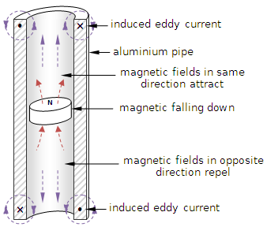
Question Title
Solution
Question Title
Answer: B
Justification: According to Lenz's law, a magnet through a metal tube (gun in our case) will be slower than a regular metal bullet (see previous question). Having slower bullets that might not penetrate zombies as much would be disadvantageous, so using these "magic bullets" does not seem like the best option. Therefore the correct answer is B.
Source: http://www.boredofstudies.org/wiki/images/a/aa/Sci_phys_motor_eddy.png

Slide 10
Question Title
Solution continued
Question Title
Expanded explanation:
A) A magnet moving through a metal will induce eddy currents in the metal that produces a magnetic field to oppose the change in magnetic flux that the moving magnet creates as it moves through the tube. This opposing magnetic field slows the magnet down; the poles of this opposing magnetic field are oriented in a fashion that repel the magnet from underneath and attract the magnet from above according to the picture on the previous page. A slower bullet is going to lose the penetrating effect you want to shoot zombies.
B) Correct. Regular metal bullets are good.
C) Even if both bullets have gunpowder in them, the magnetic induction in the metal guns will slow the "magic bullets" down.
D) Physics can help save lives!

