Slide 1
Physics Energy Problems
FACULTY OF EDUCATION
Department of
Curriculum and Pedagogy
Science and Mathematics Education Research Group
Supported by UBC Teaching and Learning Enhancement Fund 2012-2015
Notes:
Categories: Secondary – Physics – Work
Tags: Secondary, Physics, Word, Forces, Kinetic Energy, Potential Energy, Mechanical Energy
Excerpt: Find out the relationships between work, mechanical energy, and the law of conservation of energy.

Slide 2
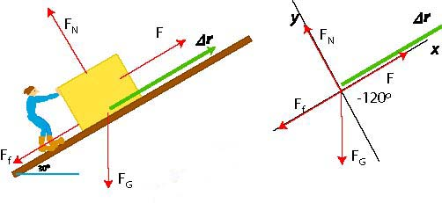
Question Title
Energy Problems
Question Title
Retrieved from: http://gauss.vaniercollege.qc.ca/pwiki/index.php/Work-Energy_Theorem_EX_2

Slide 3
Question Title
Energy Problems
Question Title
The following questions have been compiled from a collection of questions submitted on PeerWise (https://peerwise.cs.auckland.ac.nz/) by teacher candidates as part of the EDCP 357 physics methods courses at UBC.

Slide 4
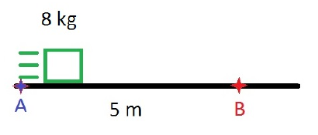
Question Title
Energy Problems I
Question Title
An 8 kg block is launched from point A to point B over a rough surface. As the block passes point B, it has slowed down to a velocity of 4.0 m/s and it has generated 36 J of heat energy. What was the kinetic energy when it was launched from point A?
36 J
136 J
100 J
64 J

Slide 5
Question Title
Solution
Question Title
Answer: C
Justification: Note that the focus of this problem is based on the transformation and conservation of mechanical energy. At point B, the speed ($v=4 m/s$) and mass ($m=8 kg$) of the box can be used to find the kinetic energy,${KE}_{B}$. So, ${KE}_{B}= \frac{1}{2} m v^{2}=\frac{1}{2} ×8 {×4}^{2} =64 J$.
The total energy, ${TE}_{B}$, of the system at B is given by the kinetic energy and the heat energy, ${HE}_{B}$, and so ${TE}_{B}={KE}_{B}+{HE}_{B}=64 J+36 J=100 J$.
Moving from point A to point B, there is no loss or gain of mechanical energy, but only a transformation from kinetic energy to heat energy. Thus the total energy at point A, ${TE}_{A}$, must equal the total energy at point B. This implies that ${TE}_{A}={TE}_{B}=100 J.$ Therefore, the correct answer is C.

Slide 6
Question Title
Energy Problems II
Question Title
An orange with mass " $m$" and radius " $r$" hangs from a tree at height " $h$". A time later, the orange has grown to a radius of $2r$. If we assume that the orange has uniform and constant density, by how much has the potential energy of the orange increased over this time?
The potential energy has increased by a factor of 2.
The potential energy has increased by a factor of 4.
The potential energy has increased by a factor of 6.
The potential energy has increased by a factor of 8.
The potential energy has increased by a factor of 10.

Slide 7
Question Title
Solution
Question Title
Answer: D
Justification: The potential energy of the orange near the surface of the earth is given by $E_{p}=m g h$.
Within reason, we will make three assumptions.
Acceleration due to gravity, $g$, is constant.
The height of the orange, $h$, does not change.
The orange is roughly spherical.
Since we have assumed that the density is uniform and constant ($ρ=\frac{m}{V}$), we know that the mass and volume ($V$) of the orange are proportional ($m ∝V$). And also, the volume ($V= \frac{4}{3} π r^{3}$) of the spherical orange is proportional to the cube of its radius ($V ∝ r^{3}$).

Slide 8
Question Title
Solution continued
Question Title
Answer: D
Thus, when the radius of the orange increases by a factor of 2, the volume increases by a factor of $2^{3}=8$, because ($V ∝ r^{3}$). This also implies that the mass increases by a factor of 8, because ($m ∝V$).
Hence, the orange's potential energy increases by a factor of 8, because ($E_{P}∝m$).
Therefore, the correct answer is D.

Slide 9
Question Title
Energy Problems III
Question Title
Fast Guy and Slow Guy have roughly the same mass. Fast Guy walks up a flight of stairs in time "t". Slow Guy walks up the same flight of stairs in time "4t“ (i.e. Slow Guy is 4 times slower than Fast Guy.) What is the difference in the amount of work done by Fast Guy and Slow Guy after they finish climbing the stairs?
Fast Guy does about 4 times as much work as Slow Guy.
Fast Guy does about 2 times as much work as Slow Guy.
Fast Guy does about the same amount of work as Slow Guy.
Slow Guy does about 2 times as much work as Fast Guy.
Slow Guy does about 4 times as much work as Fast Guy.

Slide 10

Question Title
Solution
Question Title
Answer: C
Justification: Remember that gravity exerts a constant downward force on every object. For instance, if an object is displaced upwards (or downwards), then the work done, $W$, on the object is given by $W=m g ∆y$, where $m$ is the mass of the object, $g$is the acceleration due to gravity, and $∆y$is the change in height. Here, it is important to notice that the amount of work done depends only on the the vertical movement of an object.
Furthermore, we should also note that the amount of work done does not depend on the time. Since Fast Guy and Slow Guy have roughly the same mass and climb the same flight of stairs, regardless of the time taken to climb the stairs, both people do roughly the same amount of work to climb the stairs. Thus, C is the correct answer.

Slide 11
Question Title
Energy Problems IV
Question Title
An object of mass "$m$" is dropped and it falls to the ground. As it falls, what can be said about its kinetic and potential energies?
Its kinetic energy increases while its potential energy decreases.
Its kinetic energy decreases while its potential energy increases.
Both its kinetic and potential energies increase.
Both its kinetic and potential energies decrease.

Slide 12

Question Title
Solution
Question Title
Answer: A
Justification: The kinetic energy,$E_{K}= \frac{1}{2} m v^{2}$, of an object is the energy it possesses due to its motion, where $m$ is the mass and $v$ is the velocity of the object. As the object falls to the ground, it accelerates downward due to gravity. The resulting increase in its velocity leads to an increase in its kinetic energy ($E_{K}∝ v^{2}$).
The potential energy, $E_{P}=m g h$, is the energy possessed by an object in a given position relative to a reference position, where $m$ is the mass of the object, $g$ is the acceleration due to gravity, and $h$ is the height of the object. As the object falls to the ground, the height decreases relative to the ground. The resulting decrease in the height of the object leads to a decrease in its potential energy ($E_{P}∝h$).
Thus, A is the correct answer.

Slide 13
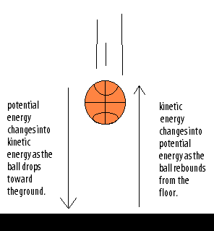
Question Title
Solution continued
Question Title

Slide 14
Question Title
Energy Problems V
Question Title
A ball is thrown at a wall and bounces back with an equal speed. Which of the following are true?
The kinetic energy of the ball is the same before and after the collision.
The momentum of the ball is the same before and after the collision.
Both A and B.
None of the above.

Slide 15
Question Title
Solution
Question Title
Answer: A
Justification: Note that the velocity of the ball changes, however its magnitude (speed) remains constant before and after the collision against the wall. Recall that the kinetic energy of an object is a scalar quantity. In this case, the kinetic energy of the ball remains constant before and after the collision.
Momentum of an object is a vector quantity, which depends on the direction of the motion. As the direction of velocity changes, the momentum’s direction changes. In this case, as the direction of the velocity of the ball changes after the collision, the momentum of the ball changes direction as well.
Thus, A is the correct answer.

Slide 16
Question Title
Energy Problems VI
Question Title
An object with mass "$m$" is initially moving at a velocity of 10 m/s ($v_{i}=10 m/s$). In order to double this object's kinetic energy, what must its final velocity be ($v_{f}$)?
7 m/s
10 m/s
14 m/s
16 m/s
20 m/s

Slide 17
Question Title
Solution
Question Title
Answer: C
Justification: Remember, kinetic energy is the energy of motion and it depends on the mass ($m$) and speed ($v$) of the object. The kinetic energy of an object is given by $E_{K}= \frac{1}{2} mv^{2}.$
Here, we are given that the final kinetic energy, $E_{Kf}$, of the object is double its initial kinetic energy, $E_{Ki}$. That is, $E_{Kf}=2E_{Ki}$. So, $E_{Kf}=\frac{1}{2} m {v_{f}}_{}^{2}= 2×\frac{1}{2} m {v_{i}}_{}^{2}$. This simplifies to ${v_{f}}_{}^{2}=2{v_{i}}_{}^{2}$, which leads to $v_{f}= \sqrt{2} v_{i}=\sqrt{2} ×10 ≅14 m/s$.
Thus, C is the correct answer.

