Slide 1
Energy Problems
FACULTY OF EDUCATION
Department of
Curriculum and Pedagogy
Science and Mathematics Education Research Group
Supported by UBC Teaching and Learning Enhancement Fund 2012-2015
Notes:
Categories: Secondary – Physics – Energy
Tags: kinetic energy, gravitational potential energy, elastic and inelastic collisions, total mechanical energy, potential elastic energy
Excerpt: Use these physics problems to test your knowledge on many different energy problems

Slide 2
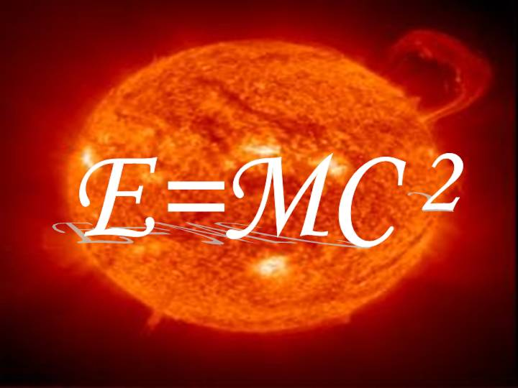
Question Title
Energy Problems
Question Title
Retrieved from: http://www.success.co.il/knowledge/images/matter-and-energy-Physics-e=mc2.jpg

Slide 3
Question Title
Energy Problems
Question Title
The following questions have been compiled from a collection of questions submitted on PeerWise (https://peerwise.cs.auckland.ac.nz/) by teacher candidates as part of the EDCP 357 physics methods courses at UBC.

Slide 4
Question Title
Energy Problems I
Question Title
An object is lifted to some height and then dropped. During the drop, which of the following is increased?
Neglect air resistance.
Kinetic energy only
Gravitational potential energy only
Kinetic energy and total mechanical energy
Kinetic energy and gravitational potential energy
None of the above

Slide 5
Question Title
Solution
Question Title
Answer: A
Justification: Total mechanical energy is the sum of all energy. In this question, it is the sum of kinetic and potential energies because the air resistance is neglected. Due to the conservation of energy, the sum of kinetic and potential energies is the same throughout the drop of the object.
As the object falls down, its velocity increases due to gravity. So, its kinetic energy increases. On the other hand, its height from the ground decreases so the potential energy decreases. Overall, the sums of kinetic and potential energies at any height during the drop are the same.
Therefore, the total mechanical energy stays the same, the kinetic energy increases and the gravitational potential energy decreases.
Thus, the answer is kinetic energy only which is option A.

Slide 6
Question Title
Energy Problems II
Question Title
Which of the following statements is TRUE?
In an elastic collision kinetic energy is conserved but momentum of the system is not
In an inelastic collision kinetic energy is conserved but momentum of the system is not
In an elastic collision kinetic energy is lost through temporary deformation of the objects
In an inelastic collision kinetic energy is lost but momentum of the system is conserved
In either type of collision kinetic energy is always conserved

Slide 7
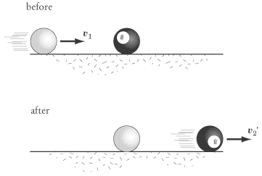
Question Title
Solution
Question Title
Answer: D
Justification: The concepts involved in this question are:
1) In an elastic collision kinetic energy is conserved due to the temporary deformation of the objects. This occurs in cases such as billiard ball collisions during a pool game, as seen here:

Slide 8
Question Title
Solution continued
Question Title
2) In an inelastic collision total energy is still conserved but some kinetic energy is lost and transformed into energy in the form of sound, thermal energy, or permanent deformation of the objects. An example of this is can be observed in the case of a car collision, where there is a large sound and the car body is deformed upon impact.
3) Momentum is conserved in both elastic and inelastic collisions.
A) Incorrect - disagrees with statement 3
B) Incorrect - disagrees with statements 2 and 3
C) Incorrect - disagrees with statement 1
D) Correct - agrees with statements 2 and 3
E) Incorrect - disagrees with statement 2

Slide 9
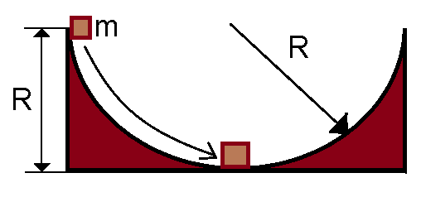
Question Title
Energy Problems III
Question Title
A block of mass m is released from rest at the top of a semi-circular frictionless track of radius R.

Slide 10
Question Title
Energy Problems III continued
Question Title
Which of the following expressions most accurately represents the speed of the block at the bottom of the track?
g is the acceleration due to gravity.

Slide 11
Question Title
Solution
Question Title
Answer: B
Justification: To solve this problem we need to use the conservation of energy.
At the top of the track, the block has potential energy of:
Since it is stationary at the top of the track, it has no kinetic energy and therefore the total mechanical energy of the block is equal to E_{P}.
At the bottom of the track, the block has kinetic energy of:
Since we have used the bottom of the track to represent ground zero, the block has no potential energy at this point, and therefore the total mechanical energy of the block is equal to E_{K}.
Since the track is frictionless, the only energies we are dealing with are Kinetic and Potential energy. Therefore no energy is lost due to heat or friction, so the total mechanical energy will be the same at the top and bottom of the track.

Slide 12
Question Title
Solution continued
Question Title
Therefore:
(answer B)

Slide 13
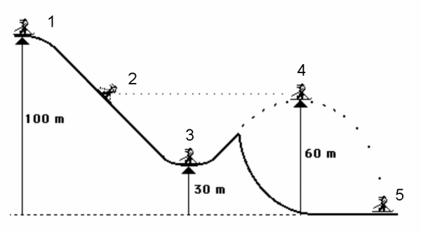
Question Title
Energy Problems IV
Question Title
A 50kg ski jumper skis down a frictionless slope as shown below. The skier is stationary at point 1.

Slide 14
Question Title
Energy Problems IV continued
Question Title
At which point is the following true?
1
2
3
4
Both 2 and 4

Slide 15
Question Title
Solution
Question Title
Answer: E
Justification: This problem can be solved numerically by calculating the gravitational potential energy at each of the five points using:
For the numbers 1 through 5 we would get the E_{P} to be 50kJ, 30kJ, 15kJ, 30kJ, and 0kJ respectively.
Since we know that at point 1, the skier has no velocity (and therefore no kinetic energy E_{K}), then the total mechanical energy is equal to E_{P} at that point (50kJ). Due to the lack of friction, we know that the total mechanical energy will be equal at all points of the skier’s trajectory, and that no energy will be converted into heat due to friction. Therefore we can calculate E_{K} at points 1 through 5 by subtracting E_{P} from the total mechanical energy – and so we get E_{K} to be 0kJ, 20kJ, 35kJ, 20kJ, and 50kJ respectively.

Slide 16
Question Title
Solution continued
Question Title
From there we can calculate the ratios between E_{P} and E_{K}, and we will find that at points 2 and 4 (answer E).
However, this question is easier to solve if we see that neither potential nor kinetic energy can be zero. Therefore we can rule out point 1 (answer A), since E_{K} is zero at this point. We can also see that for the ratio to hold true, E_{P} > E_{K}, and therefore the skier must still be more than halfway up the slope. Therefore we can rule out answer C. Since points 2 and 4 are on the same elevation (60m), the answer must be E.

Slide 17
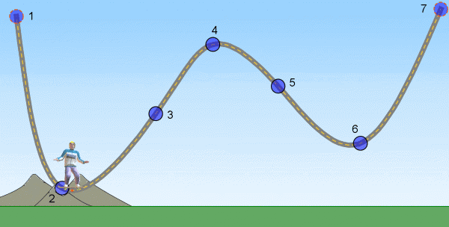
Question Title
Energy Problems V
Question Title
A total radical skater dude is doing sweet tricks on an epic (frictionless) skate track.
Y
0
0
X

Slide 18
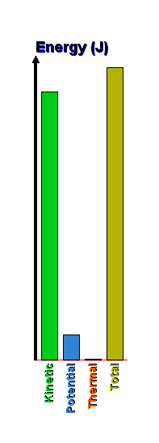
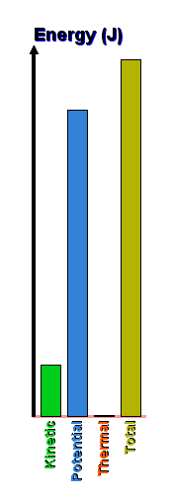
Question Title
Energy Problems V continued
Question Title
If he starts from rest at point 1, which graph represents his E_{P} and E_{K} best at point 2?
A.
B.
C.
D.
E.

Slide 19
Question Title
Solution
Question Title
Answer: C
Justification: As the skater descends the track, his initial potential energy is converted without loss (no friction) into kinetic energy.
As point 2 is the lowest point on the track, the skater will have maximum kinetic energy at this point, so you may be tempted to select option D, which shows 0% potential energy, and 100% kinetic energy. However, point 2 is not at ground level, which is the point of reference for calculating potential energy (using the axes provided), and so the skater will still have some potential energy. Thus, D is incorrect.
As the skater is clearly closer to the ground than to the top of the track, his E_{K} will be greater than his E_{P}, so A and B are incorrect. He is also very obviously not at the top of the track, so he will have at least some E_{K}, so E is also incorrect.
Thus, C must be the right answer, with E_{K} > E_{P}, but E_{P} > 0.

Slide 20
Question Title
Energy Problems VI
Question Title
An ice cube of mass m is placed on the rim of a hemispherical glass bowl of radius r and then released to slide inside it.
v is the tangential velocity of the ice cube at the bottom of the bowl, and a_{R} is its radial acceleration.
r
a_{R}
v

Slide 21
Question Title
Energy Problems VI continued
Question Title
What are v² and a_{R} of the ice cube as it reaches the bottom of the bowl (point 1)?
g is the acceleration due to gravity.
v² = gr and a_{R} = g
v² = 2gr and a_{R} = 2g
v² = ½gr and a_{R} = ½mg
v² = 2gr and a_{R} = 2mg
v² = ½gr and a_{R} = ½g

Slide 22
Question Title
Solution
Question Title
Answer: B
Justification: To solve this question we can use the conservation of mechanical energy (here we are assuming there is no friction between the block of ice and the bowl). At the rim of the bowl, the ice cube posses only potential energy (E_{P}), and no kinetic energy (E_{K}). If we take the bottom of the bowl to be our zero ground, then at the bottom of the bowl the ice cube posses only E_{K} and no E_{P}. Therefore the potential energy of the ice cube at the bowl rim is entirely converted to kinetic energy at the bottom. We can express this using formulas:

Slide 23
Question Title
Solution continued
Question Title
To solve for the radial acceleration, we use the following formula:
Therefore the answer is v² = 2gr and a_{R} = 2g (answer B)
Notice here that we did not need to make use of the mass of the ice block (m). In fact, we could have easily ruled out options C and D by realizing that the units for a_{R} are in kg.m/s², which is the unit for force, and not acceleration.

Slide 24
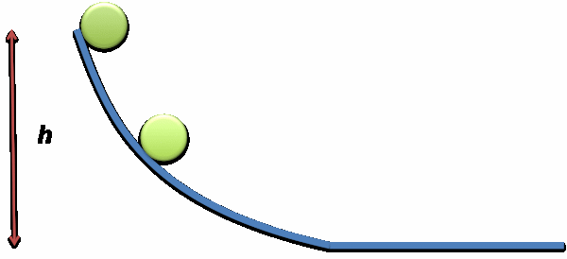
Question Title
Energy Problems VII
Question Title
A marble was released at height h and it gained a final velocity of v at the bottom of the frictionless slide. If the same marble in the diagram below is released from rest at ½h, what would be its new final velocity in terms of v at the bottom of the slide?
½h

Slide 25
Question Title
Solution
Question Title
Answer: C
Justification: To solve this question we can use the conservation of mechanical energy (the slide is frictionless and therefore no energy is converted into heat energy).
Situation 1: At the top of the slide, the marble posses only potential energy (E_{P}), and no kinetic energy (E_{K}). If we take the bottom of the slide to be our zero ground, then at the bottom of the slide the marble posses only E_{K} and no E_{P}. Therefore the potential energy of the marble at the top of the slide is entirely converted to kinetic energy at the bottom. We can express this using formulas:

Slide 26
Question Title
Solution continued
Question Title
Now we can look at the situation where the marble starts halfway down the slide (at ½h). In this case we will also get conservation of mechanical energy:
Since we know that the original velocity v = 2gh, we can express the new velocity v₂ in terms of v:
Therefore:
(answer C)

Slide 27
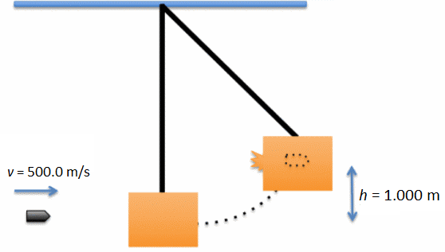
Question Title
Energy Problems VIII
Question Title
A 9.000 g bullet is shot into a 5.000 x 10⁻¹ kg crate hanging on the wall. As a result, the crate swings up a maximum height of 1.000 m with the bullet embedded inside the crate.

Slide 28
Question Title
Energy Problems VIII continued
Question Title
Which of the following statements is FALSE?
The bullet has a kinetic energy of 1125 J.
The tension in the string did 0 J of work.
All the bullet's kinetic energy was converted into the gravitational potential energy.
Some of the bullet's kinetic energy was converted into heat energy as the crate stopped the bullet.

Slide 29
Question Title
Solution
Question Title
Answer: C
Justification: If we take the initial height of the bullet and crate as the zero ground, then we can say that the potential energy (E_{P}) of the system was zero before the bullet hit the crate. Since the crate was stationary, the only energy of the system before the collision was the kinetic energy (E_{K}) of the bullet. We can calculate this energy:
Note: Don’t forget to convert the 9.000 g into 0.009 kg
Therefore the total energy of the system before the collision is 1125 J.
After the collision, the crate reaches a height of 1.000 m. At the height of the swing, both the crate and the bullet are stationary, therefore they do not possess any kinetic energy. Therefore the total mechanical energy of the system can be represented by the potential energy of the crate and bullet at the maximum height of the swing.

Slide 30
Question Title
Solution continued
Question Title
We can calculate this potential energy:
Note: Don’t forget to add the mass of the crate and bullet together
Therefore the total mechanical energy (potential plus kinetic) of the system after the collision is only 4.988 J. But we know that the bullet supplied a kinetic energy of 1125 J to the system, therefore the rest of the energy must have been converted into heat energy or energy of deformation as the bullet struck the crate.
Now we can look at the answers individually and see which ones are true and false (remember that we are looking for the false answer):
A) This is true as we have calculated it (E_{kbullet} = 1125 J)
B) Since the tension in the string is perpendicular to the motion of the crate, it has no component in the direction of the crate’s motion and therefore did 0 J of work. Therefore this answer is true.

Slide 31
Question Title
Solution continued 2
Question Title
C) Since we know that a large proportion of the kinetic energy of the bullet was ‘lost’ during the collision, we know that not all of the bullet’s kinetic energy was converted to gravitational potential energy. Therefore this answer is false.
D) We know that a large amount of the bullet’s initial kinetic energy was converted to other forms of energy during the collision, therefore this answer is true.
Since C is the only answer which is false, it is the correct answer.

Slide 32
Question Title
Energy Problems IX
Question Title
A 9.000 g bullet is shot into a 5.000 x 10⁻¹ kg crate hanging on the wall. As a result, the crate swings up a maximum height of 1.000 m with the bullet embedded inside the crate.

Slide 33
Question Title
Energy Problems IX continued
Question Title
If all the lost kinetic energy was converted into thermal energy heating up the wooded crate, what is the final temperature of the wood crate if it was initially at room temperature (20.00 °C)?
The specific heat capacity of wood is 1700 J.kg⁻¹.°C⁻¹.
The acceleration due to gravity is 9.8 m/s².
20.00 ºC
21.26 ºC
21.29 ºC
21.32 ºC

Slide 34
Question Title
Solution
Question Title
Answer: D
Justification: If we take the initial height of the bullet and crate as the zero ground, then we can say that the potential energy (E_{P}) of the system was zero before the bullet hit the crate. Since the crate was stationary, the only energy of the system before the collision was the kinetic energy (E_{K}) of the bullet. We can calculate this energy:
Note: Don’t forget to convert the 9.000 g into 0.009 kg
Therefore the total energy of the system before the collision is 1125 J.
After the collision, the crate reaches a height of 1.000 m. At the height of the swing, both the crate and the bullet are stationary, therefore they do not possess any kinetic energy. Therefore the total mechanical energy of the system can be represented by the potential energy of the crate and bullet at the maximum height of the swing.

Slide 35
Question Title
Solution continued
Question Title
We can calculate this potential energy:
Note: Don’t forget to add the mass of the crate and bullet together
Therefore the total mechanical energy (potential plus kinetic) of the system after the collision is only 4.988 J. But we know that the bullet supplied a kinetic energy of 1125 J to the system, therefore the rest of the energy must have been converted into heat energy:
We can now use this to calculate by how much the temperature of the crate increased. To do this we will use the formula for heat capacity:
Q = mc∆T, where Q is the heat energy, m is the mass of the crate, c is the specific heat capacity of wood, and ∆T is the change in temperature

Slide 36
Question Title
Solution continued 2
Question Title
We know the initial temperature of the crate (20.00 °C), therefore:
Therefore the correct answer is D

Slide 37
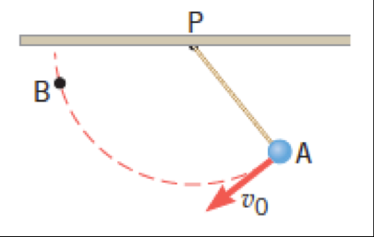
Question Title
Energy Problems X
Question Title
A ball is fixed to the end of a string, which is attached to the ceiling at point P. As the drawing shows, the ball is projected downward at A with the launch speed v₀. Traveling on a circular path, the ball comes to a halt at point B.

Slide 38
Question Title
Energy Problems X continued
Question Title
What enables the ball to reach point B, which is above point A? Ignore friction and air resistance.
The work done by the tension in the string.
The ball's initial gravitational potential energy.
The ball's initial kinetic energy.
The work done by the gravitational force.

Slide 39
Question Title
Solution
Question Title
Answer: C
Justification: This is a conservation of energy question. Since point B is above point A, the ball will have a greater gravitational potential energy at point B than point A. Therefore in order for energy to be conserved, the ball must have had some kinetic energy at point A (for example giving the ball a push), so that it will have the energy to reach point B. If we look at all the possible answers:
A) The work done by the tension in the string is zero because the tension force is perpendicular to the motion of the ball. Therefore this answer is incorrect.
B) Without an input of other energy, the ball does not have enough gravitational potential energy at point A to reach point B if it was just let go. Therefore this answer is incorrect.

Slide 40
Question Title
Solution continued
Question Title
C) If you give the ball a push at point A instead of letting it go you would give it more kinetic energy, which will be converted into gravitational potential energy at point B. Therefore this answer is correct.
D) While the gravitational force would help the ball accelerate downwards, this will not necessarily help it reach point B since we know that at point B the ball will have more gravitational potential energy than at point A. Without giving the ball extra energy, the ball would only be able to reach the same height as it was at point A. Therefore this answer is incorrect.

Slide 41
Question Title
Energy Problems XI
Question Title
A moving body of mass m collides with a stationary body of double the mass, 2m, sticks to it and continues moving. What fraction of the original kinetic energy is lost?
2m
2m
m
m
¹/₄
¹/₃
¹/₂
²/₃
³/₄

Slide 42
Question Title
Solution
Question Title
Answer: D
Justification: For this question we will need to use conservation of momentum to help determine how much kinetic energy was lost in the collision (this is an inelastic collision since kinetic energy was lost to heat/deformation/etc.).
Let us draw the picture again and add in all the values we need:
BEFORE
AFTER
2m
2m
v₂
m
v₁
m

Slide 43
Question Title
Solution continued
Question Title
Initially, the kinetic energy of the system is:
After the collision, the two bodies move as one with a speed of v₂.
Conservation of momentum would determine that:
Therefore the kinetic energy of the system after the collision is:
So the lost kinetic energy is:

Slide 44
Question Title
Solution continued 2
Question Title
Finally, we need to calculate the fraction of the original kinetic energy that was lost. We do this by dividing the amount that was lost by the original amount:
(answer D)
Most collisions are inelastic because kinetic energy is transferred to other forms of energy – such as thermal energy, potential energy, and sound – during the collision process.
A perfectly inelastic collision is one in which the maximum amount of kinetic energy has been lost during a collision, making it the most extreme case of an inelastic collision. In most cases, you can tell a perfectly inelastic collision because the objects in the collision "stick" together, sort of like a tackle in American football.

Slide 45
Question Title
Energy Problems XII
Question Title
h
½h
0
ground level

Slide 46
Question Title
Energy Problems XII continued
Question Title
The speeds of the rollercoaster cart at height h, ½h and at ground level can best be described by the ratio:
1:2:3
1:4:9
3:2:1
9:4:1
10:14:17
Note: Choose the best answer for the ratio of h:½h:ground level

Slide 47
Question Title
Solution
Question Title
Answer: E
Justification: For this question we will need to use conservation of mechanical energy (the rollercoaster is frictionless so there is no energy converted to heat energy).
We can look at each different height of the rollercoaster separately and find out what the speed of the cart is at each level.
At height h:
We know that at this height the speed of the cart
We can also find out the total mechanical energy (kinetic plus potential) of the cart:

Slide 48
Question Title
Solution continued
Question Title
At height ½h:
First we need to find out the total mechanical energy (kinetic plus potential) of the cart at ½h:
Since total mechanical energy is conserved, we know that the total mechanical energy at height h is the same as at height ½h:

Slide 49
Question Title
Solution continued 2
Question Title
At height 0 (ground level):
First we need to find out the total mechanical energy (kinetic plus potential) of the cart at ground level:
Since total mechanical energy is conserved, we know that the total mechanical energy at height h is the same as at ground level:

Slide 50
Question Title
Solution continued 2
Question Title
Now we can compare the ratios of the speeds at h, ½h and ground level:
1 : 1,4 : 1,7
This ratio expressed to the nearest integer ratio is 10:14 :17
Therefore the correct answer is E.

Slide 51
Question Title
Energy Problems XIII
Question Title
A spring is placed on a table and compressed past its equilibrium point by a distance of ∆x as shown in the diagram below:
Assume that the spring is being held in place by an external force until time 1, which is the instant that this force is removed from the mass (this is the moment before the mass starts moving due to the expansion of the spring). At time 1 the system begins with exactly 6 J of energy.

Slide 52
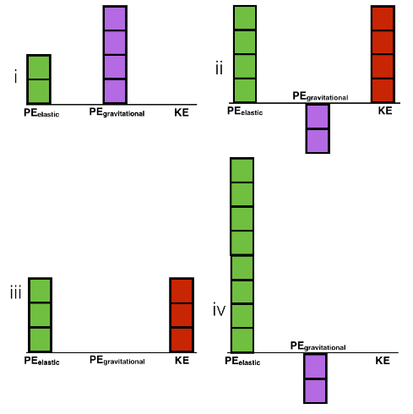
Question Title
Energy Problems XIII continued
Question Title
Based on the diagram what are possible representations of the energy distribution of the system at time 1? Choose all that apply:
Note: Each block represents 1 J of energy, blocks above the line are positive energies and blocks below the line are negative energies
i only
ii only
i & iv
ii & iv
iii only

Slide 53
Question Title
Solution
Question Title
Answer: C
Justification: To answer this question we need to identify the possible PE_{elastic} (potential elastic energy), PE_{gravtitational} (potential gravitational energy) and KE (kinetic energy) at time 1.
PE_{elastic}: The spring is compressed by ∆x and therefore there is potential energy stored in the spring. PE_{elastic} = ½∆x². This means that PE_{elastic} must be greater than zero (because ∆x² is squared).
PE_{gravtitational}: The potential energy due to gravity depends on where you choose the origin to be. Therefore, PE_{gravtitational} can be negative, zero or positive because PE_{gravtitational} = mgh, where h depends on where the origin is chosen to be.
If the origin is above the table PE_{gravtitational} < 0, if the origin is along the table PE_{gravtitational} = 0, and if the origin is below the table PE_{gravtitational} > 0.

Slide 54
Question Title
Solution continued
Question Title
KE: The equation for the kinetic energy of an object is KE = ½mv². At time 1 we know that the initial velocity is zero (the mass has not started moving yet), therefore this must mean that KE = 0.
If we look at the possible options for the energy distribution of the system at time 1, we can see that all satisfy the condition that there are 6J of energy in the system. We can discount options (ii) and (iii) since they show a positive amount of kinetic energy, and we know this must be zero. Both options (i) and (iv) have positive PE_{elastic}, which we know must be true. Option (i) has positive PE_{gravtitational:}, while option (iv) has negative PE_{gravtitational}. Since we know PE_{gravtitational} can be both positive and negative, both options (i) and (iv) could be true. Therefore the correct answer is C.

Slide 55
Question Title
Energy Problems XIV
Question Title
A spring is placed on a table and compressed past its equilibrium point by a distance of ∆x as shown in the diagram below:
Assume that the spring is being held in place by an external force until time 1, which is the instant that this force is removed from the mass. At time 1 the system begins with exactly 6 J of energy. Time 2 is the moment when the spring and the mass lose contact (this is when the spring reaches its equilibrium length).

Slide 56
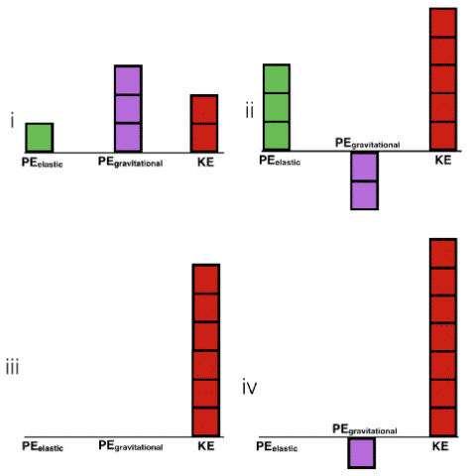
Question Title
Energy Problems XIV continued
Question Title
Based on the diagram what are possible representations of the energy distribution of the system at time 2? Choose all that apply:
Note: Each block represents 1 J of energy, blocks above the line are positive energies and blocks below the line are negative energies
i only
iii only
i & ii
iii & iv
iii only

Slide 57
Question Title
Solution
Question Title
Answer: D
Justification: To answer this question we need to identify the possible PE_{elastic} (potential elastic energy), PE_{gravtitational} (potential gravitational energy) and KE (kinetic energy) at time 2.
PE_{elastic}: At time 2 the spring is no longer compressed and ∆x = 0. Therefore PE_{elastic} = ½∆x² = 0.
PE_{gravtitational}: The potential energy due to gravity depends on where you choose the origin to be. Therefore, PE_{gravtitational} can be negative, zero or positive because PE_{gravtitational} = mgh, where h depends on where the origin is chosen to be.
If the origin is above the table PE_{gravtitational} < 0, if the origin is along the table PE_{gravtitational} = 0, and if the origin is below the table PE_{gravtitational} > 0.

Slide 58
Question Title
Solution continued
Question Title
KE: Here we know that the velocity of the object is not zero. The equation for the kinetic energy of an object is KE = ½mv². We know that for this case all the terms in this equation must be greater than zero (mass cannot be negative and velocity is squared). This means that the kinetic energy must be greater than zero.
If we look at the possible options for the energy distribution of the system at time 1, we can see that all satisfy the condition that there are 6J of energy in the system. We can discount options (i) and (ii) since they show a positive amount of PE_{elastic}, and we know this must be zero. Both options (iii) and (iv) have positive kinetic energy, which we know must be true. Option (iii) has zero PE_{gravtitational:}, while option (iv) has negative PE_{gravtitational}. Since we know PE_{gravtitational} can be both zero and negative, both options (iii) and (iv) could be true. Therefore the correct answer is D.

Slide 59
Question Title
Energy Problems XV
Question Title
A spring is placed on a table and compressed past its equilibrium point by a distance of ∆x as shown in the diagram below:
Assume that the spring is being held in place by an external force until time 1, which is the instant that this force is removed from the mass. At time 1 the system begins with exactly 6 J of energy. Time 2 is the moment when the spring and the mass lose contact. Time 3 is the final position of the mass after it has stopped moving along the table.

Slide 60
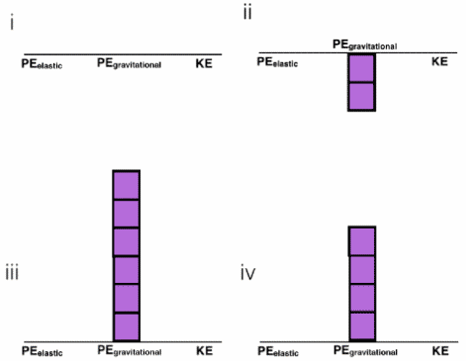
Question Title
Energy Problems XV continued
Question Title
Based on the diagram what are possible representations of the energy distribution of the system at time 3? Choose all that apply:
Note: Each block represents 1 J of energy, blocks above the line are positive energies and blocks below the line are negative energies
i only
iii & iv
i, iii & iv
i, ii & iv
All answers are possible

Slide 61
Question Title
Solution
Question Title
Answer: D
Justification: To answer this question we need to identify the possible PE_{elastic} (potential elastic energy), PE_{gravtitational} (potential gravitational energy) and KE (kinetic energy) at time 3.
However, here it is important to note that some of the energy of the system must be lost in order for the block to come to a stop on the table. This energy is converted into heat energy due to the force of friction between the mass and the table. If no energy was lost in the system, the block would never come to a stop. This means that the total energy of the system is now smaller than 6J:
PE_{elastic} + PE_{gravtitational} + KE < 6J
PE_{elastic}: At time 3 the spring is no longer compressed and ∆x = 0. Therefore PE_{elastic} = ½∆x² = 0.

Slide 62
Question Title
Solution continued
Question Title
PE_{gravtitational}: The potential energy due to gravity depends on where you choose the origin to be. Therefore, PE_{gravtitational} can be negative, zero or positive because PE_{gravtitational} = mgh, where h depends on where the origin is chosen to be.
If the origin is above the table PE_{gravtitational} < 0, if the origin is along the table PE_{gravtitational} = 0, and if the origin is below the table PE_{gravtitational} > 0.
KE: The equation for the kinetic energy of an object is KE = ½mv². At time 3 we know that the velocity of the mass is zero (the mass has come to a complete stop), therefore this must mean that KE = 0.
We can discount option (iii) because it still shows 6J of energy in the system, but we know it must be less. Option (i) has zero PE_{gravtitational:}, option (ii) has negative PE_{gravtitational} and option (iv) has positive PE_{gravtitational}. Since we know PE_{gravtitational} can be both zero, negative and positive, options (i), (ii) and (iv) could be true. Therefore the correct answer is D.

