Slide 1
Physics Momentum
FACULTY OF EDUCATION
Department of
Curriculum and Pedagogy
Science and Mathematics Education Research Group
Supported by UBC Teaching and Learning Enhancement Fund 2012-2015
Notes:
Categories: Secondary – Physics – Momentum
Tags: Secondary, Physics, Momentum, Collisions, Conservation of Momentum, Conservation of Energy
Excerpt: Find out how momentum is conserved in collisions along with the conservation of energy.

Slide 2
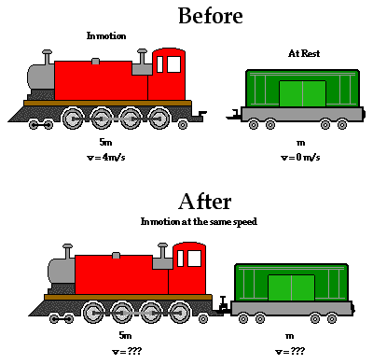
Question Title
Momentum
Question Title
http://www.physicsclassroom.com/class/momentum/Lesson-2/Using-Equations-as-a-Guide-to-Thinking

Slide 3
Question Title
Momentum
Question Title
The following questions have been compiled from a collection of questions submitted on PeerWise (https://peerwise.cs.auckland.ac.nz/) by teacher candidates as part of the EDCP 357 physics methods courses at UBC.

Slide 4
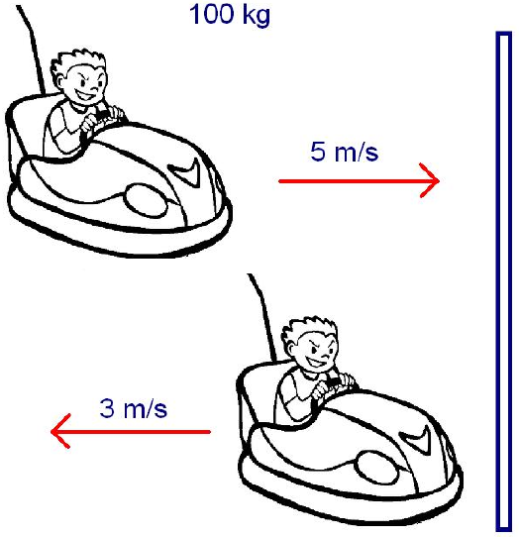
Question Title
Momentum Problems I
Question Title
A bumper car is initially driving to the right at 5 m/s. After bouncing off a wall, the bumper car is moving backwards (to the left) at 3 m/s. The car, including driver, is 100 kg. What is the change in momentum? (Consider moving to the right as moving in the positive direction)
800 kg m/s
500 kg m/s
300 kg m/s
-500 kg m/s
-800 kg m/s
Before
After

Slide 5

Question Title
Solution
Question Title
Answer: E
Justification: Recall that the quantity $m.v$ is the momentum, whereas $m.∆v$ is the change in momentum. The change in momentum is also referred to as an impulse. Impulse is defined as the product of the force acting on a body and the time interval during which the force is exerted. The impulse-momentum change equation is given by$Impulse=change in momentum$.
$change in momentum= m.∆v$, where $∆v=final velocity −initial velocity=−3−5=−8 m/s$ is the change in velocity and $m=100 kg$ is the mass of the bumper car. Thus, $m.∆v=100 ×\left(−8\right)=−800 kg m/s$ is the change in momentum (or impulse) of the car. Therefore, E is the correct answer.

Slide 6
Question Title
Momentum Problems II
Question Title
An object A, with mass $m_{A}$ and velocity $v_{1}$, collides with a stationary object B, with mass $m_{B}$. After the collision, B is travelling at $v_{1}$ and A is stationary. Which of the following are necessarily true?
Before
The collision is perfectly elastic.
Total momentum is conserved.
The system is closed.
None of the above.
A
B
$$v_{1}$$
After
A
B
$$v_{1}$$

Slide 7
Question Title
Solution
Question Title
Answer: D
Justification: We cannot assume that the masses are equal.
Case 1: Let $m_{A}> m_{B}$. If we look at the momentum before and after the collision, we notice:
Momentum before = m_{A}v_{A} + m_{B}v_{B} = m_{A}v₁ + m_{B}(0) = m_{A}v₁
Momentum after = m_{A}v_{A} + m_{B}v_{B} = m_{A}(0) + m_{B}v₁ = m_{B}v₁
Since $m_{A}> m_{B}$, then $m_{A}v_{1}> m_{B}v_{1}$.
Therefore, after the collision we can see that some of the momentum is lost. This implies that the system is not closed (a closed system is one in which the total momentum does not change).

Slide 8
Question Title
Solution continued
Question Title
Case 2: If $m_{A}= m_{B}$, we can use the same equations as above to determine that $m_{A}v_{1}= m_{B}v_{1}$. Therefore the collision was a perfectly elastic collision (no loss of momentum).
Since we cannot assume that we are operating under Case 2 ($m_{A}= m_{B}$), we cannot say for sure whether the collision is elastic, momentum is conserved, or the system is closed.
Therefore, D is the correct answer.
Note: We cannot have another case, i.e. $m_{A}< m_{B}$. This is because it is impossible for object A (smaller mass) travelling at $v_{1}$ to collide with object B (larger mass) and make object B travel at the same speed ($v_{1}$). In other words, we cannot have an increase in momentum after a collision (at least not without external forces taking part).

Slide 9
Question Title
Momentum Problems III
Question Title
There is a collision between two 1 kg carts. One is initially moving at 5 m/s and the other is initially at rest. With the information provided, can we solve for the final velocities of the carts?
Yes, we can use the law of conservation of momentum.
Yes, we can use the law of conservation of energy.
Yes, we can use the law of the conservation of momentum and the conservation of energy.
No, we cannot apply the law of conservation of energy.

Slide 10
Question Title
Solution
Question Title
Answer: D
Justification: The law of conservation of energy states that, in a closed system (isolated from its surroundings), the total energy of the system is conserved. In our case, we cannot apply the law of conservation of energy, because we don't know whether the collision is elastic or inelastic.
Also, the law of conservation of momentum states that the total momentum of a closed system does not change. That is, the total momentum of the objects before the collision is the same as the total momentum of the objects after the collision.
By using the law of conservation of momentum, we are unable to determine the final velocities of the carts, as shown on the next slide.

Slide 11
Question Title
Solution continued
Question Title
Answer: D
$$p_{i}= p_{f}$$
$$m_{1}v_{1, i}+m_{2}v_{2, i}=m_{1}v_{1, f}+m_{2}v_{2, f}$$
$$\left(1 kg\right)\left(5 m/s\right)+\left(1 kg\right)\left(0 m/s\right)=\left(1 kg\right){ v}_{1, f}+\left(1 kg\right){ v}_{2, f}$$
$$5= v_{1, f}+v_{2, f}$$
That is, we have one equation with two unknowns. Thus, D is the correct answer.
Note: The law of conservation of energy is completely different from energy conservation. Energy conservation deals with saving energy, such as insulating your home, using the public transit, or switching the lights off when not in use.
Law of conservation of momentum
Application of the law

Slide 12
Question Title
Momentum Problems IV
Question Title
Two objects (A and B) of different mass are moving in opposite directions, but at the same speed, before a head-on collision. Object A is three times more massive than object B. After the collision: object A comes to rest; the direction of object B is reversed and its speed is increased by a factor of 2. Is the momentum conserved in this collision? Is the kinetic energy conserved?
Only the total momentum is conserved.
Only the kinetic energy is conserved.
Both kinetic energy and total momentum are conserved.
Total momentum is conserved, but not the kinetic energy
Kinetic energy is conserved, but not the total momentum

Slide 13
Question Title
Solution
Question Title
Answer: C
Justification:
$$3m$$
$$m$$
$$v$$
$$v$$
Before
A
B
$$3m$$
$$m$$
Collision
A
B
$$3m$$
$$m$$
$$2v$$
After
A
B

Slide 14
Question Title
Solution continued
Question Title
Answer: C
Let the direction of object A be the positive direction.
Initial momentum = $3 m v −m v=2 m v$
Final momentum = $0 m v+2 m v=2 m v$
Initial kinetic energy = $\frac{1}{2}\left[3 m v^{2}+m v^{2}\right]=2 m v^{2}$
Final kinetic energy = $\frac{1}{2}\left[0 m v^{2}+m ({2 v)}^{2}\right]=2 m v^{2}$
Note that both the kinetic energy and the total momentum are conserved. Thus, C is the correct answer.

