Slide 1
Physics Optics Problems
FACULTY OF EDUCATION
Department of
Curriculum and Pedagogy
Science and Mathematics Education Research Group
Supported by UBC Teaching and Learning Enhancement Fund 2012-2015
Notes:
Categories: Secondary – Physics – Optics
Tags: reflection, refraction, refractive index, Snell’s Law
Excerpt: Use these physics problems to test your knowledge on optics

Slide 2
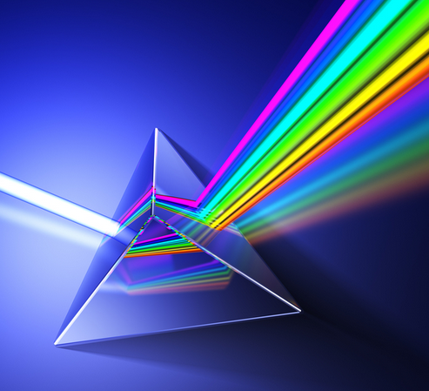
Question Title
Optics Problems
Question Title
Retrieved from: http://www.learnpedia.in/blog/optics/

Slide 3
Question Title
Optics Problems
Question Title
The following questions have been compiled from a collection of questions submitted on PeerWise (https://peerwise.cs.auckland.ac.nz/) by teacher candidates as part of the EDCP 357 physics methods courses at UBC.

Slide 4
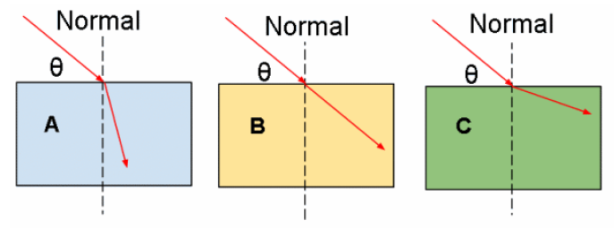
Question Title
Optics Problems I
Question Title
A ray of light enters three blocks (A, B, & C) of varied materials and refracts as shown below. The index of refraction of the three blocks are n_{A}, n_{B}, and n_{C} respectively.

Slide 5
Question Title
Optics Problems I continued
Question Title
Which of the following is correct?
Assume the rays each originate in air (ie. start in the same medium).
n_{A} = n_{B} = n_{C}
n_{B}>n_{C}>n_{A}
n_{B}>n_{A}>n_{C}
n_{A}>n_{B}>n_{C}
n_{C}>n_{B}>n_{A}

Slide 6
Question Title
Solution
Question Title
Answer: D
Justification: When a ray of light passes from one medium into another, it refracts depending on the comparative indexes of refraction of the first and second mediums. Let us call the first medium's index of refraction n_{i}.
If the two mediums have the same index of refraction, the ray will continue straight without refracting. If the second medium has a lower index of refraction, the ray will bend away from the normal (angle of incidence < angle of refraction). If the second medium has a higher index of refraction, the ray will bend towards the normal (angle of incidence > angle of refraction).
From the diagrams, we can therefore tell that n_{A}>n_{i} , n_{B}=n_{i} , and n_{C}<n_{i}
Since the first medium in all three cases in the same (air), we can then tell that n_{A}>n_{B}>n_{C} (answer D).

Slide 7
Question Title
Optics Problems II
Question Title
In geometric optics, the following statements are TRUE for real and virtual images:
If you capture sunlight in a mirror or lens you can feel the heat where the sunlight is reflected/refracted as a real image but you cannot feel the heat where the sunlight is reflected/refracted as a virtual image
You can project a real image onto a screen but you cannot do so with a virtual image
A diverging lens can create a real image
A converging lens can create a real image
Both convex and concave mirrors can create real images
i, ii & iii
i, ii & iv
i, iv & v
iv & v
iii & v

Slide 8
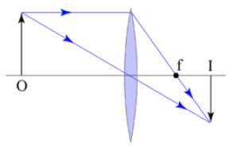
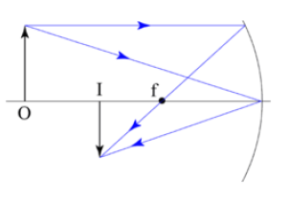
Question Title
Solution
Question Title
Answer: B
Justification: First consider the line optics of real images (from http://en.wikipedia.org/wiki/Real_image):
Convex Lens Concave Mirror
Notice that the lines that converge to form the image point are all drawn solid. This means that they are actual rays, composed of photons originating at the source objects. If you put a screen in the focal plane, light reflected from the object will converge on the screen and you'll get a luminous image (as in a cinema or a overhead projector).

Slide 9
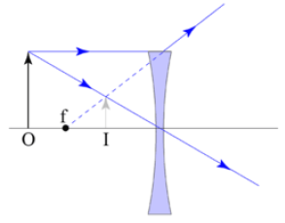
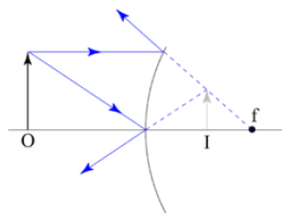
Question Title
Solution continued
Question Title
Next examine the situation for virtual images (from http://en.wikipedia.org/wiki/Virtual_image):
Concave Lens Convex Mirror
Notice here that the image is formed by a one or more dashed lines (possibly with some solid lines). The dashed lines are draw off the back of solid lines and represent the apparent path of light rays from the image to the optical surface, but no light from the object ever moves along those paths. This light energy from the object is dispersed, not collected and can not be projected onto a screen. There is still an

Slide 10
Question Title
Solution continued 2
Question Title
"image" there, because those dispersed rays all appear to be coming from the image. Thus, a suitable detector (like your eye) can "see" the image, but it cannot be projected onto a screen.
So, for the statements provided previously:
i True. Since a real image is formed where actual light rays meet there will be heat where the image is real. That is why converging lenses and concave mirrors can start fires when sunlight is pointed to focus on a combustible object.
ii True. As explained above.
iii False. As explained above.
iv True. As explained above.
v False. Only concave mirrors can produce real images.
Therefore, option B is the correct choice.

Slide 11
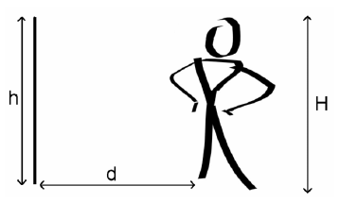
Question Title
Optics Problems III
Question Title
Sergai is a vain man. He loves to look at himself in the mirror all the time. Unfortunately, his pet lion just broke his favourite mirror, and so Sergai is shopping for a new one.

Slide 12
Question Title
Optics Problems III continued
Question Title
How tall (h) would the new mirror have to be in order for Sergai, whose height is H, to be able to see his whole body if the distance between him and the mirror (d) = ½H? What if d = H?
d = ½H d = H
h = H h = ½H
h = H h = H
h = ½H h = H
h = ½H h = ½H
h = ½H h = ¼H

Slide 13
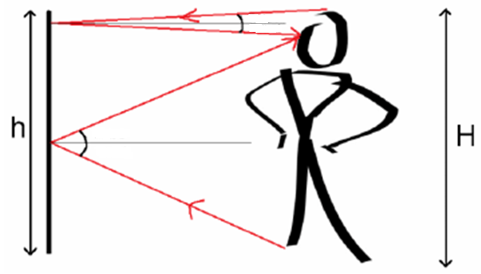
Question Title
Solution
Question Title
Answer: D
Justification: When Sergai looks at the top of his head in the mirror, the light rays travel downwards from his head to the mirror, then downwards to his eyes.
When he looks at his feet, the light travels up to the mirror from his feet, then up to his eyes.
θ₁
θ₁
θ₂
θ₂

Slide 14
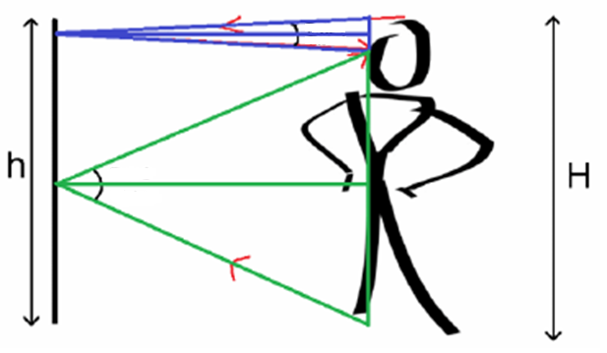
Question Title
Solution continued
Question Title
Since we know for both reflections the angle of incidence and the angle of reflection are the same (ɵ₁ for the eyes and ɵ₂ for the feet), and that the object being reflected and the observer are the same distance from the mirror (they are the same thing!), then we know that the light rays have formed two pairs of identical isosceles triangles (in blue and green).
θ₁
θ₁
θ₂
θ₂

Slide 15
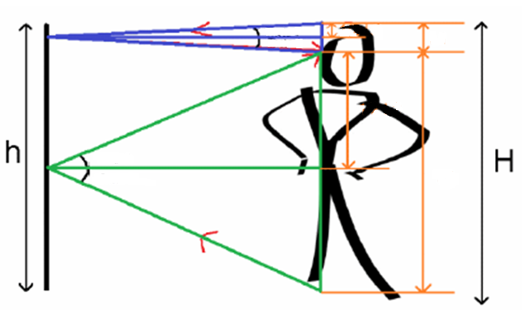
Question Title
Solution continued 2
Question Title
The long (horizontal) leg of each triangle bisects the distance between the object (head or foot) and the observer (eye), so we know that the short (vertical) legs of the triangles are equal in length to half the distance between their object and the eye (L1 and L2).
θ₁
½L₁
L₁
θ₁
½L₂
θ₂
θ₂
L₂

Slide 16
Question Title
Solution continued 3
Question Title
The distance between the two points of reflection on the mirror is therefore: ½L₁ + ½L₂
Since we know that L₁ + L₂ = H, then we can get:
½L₁ + ½L₂ = ½H
So the mirror has to be at least half as tall as Sergai in order for him to see his whole body.
You will notice that nowhere in our deduction of this answer did we consider Sergai's distance from the mirror! This is because no matter how close or how far from the mirror he stands, the same two pairs of identical, isosceles triangles will be formed, reflecting at the same points on the mirror, but with different angles of incidence/reflection.
The mirror must be ½H tall no matter where Sergai stands, so the answer is D.

Slide 17
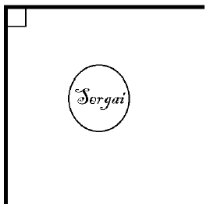
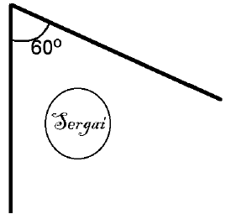
Question Title
Optics Problems IV
Question Title
Sergai decides to buy two mirrors in order to see himself better. Which arrangement should he put the two mirrors in in order to be able to see the most reflections of himself?
A. B. C. D.

Slide 18
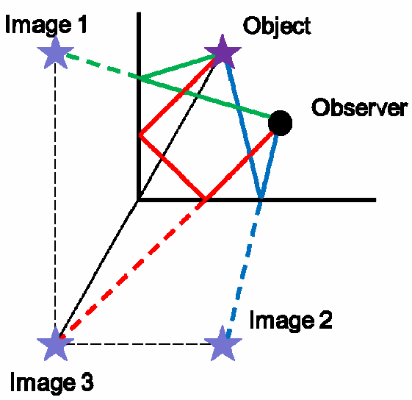
Question Title
Solution
Question Title
Answer: C
Justification: A plane mirror will only produce one reflection. Option A is essentially a single plane mirror, and will therefore only produce one reflection.
Two mirrors perpendicular to one another (Option B) will produce three images: two images from single reflections (green and blue) and one from double reflection (red).
In this image the object and observer are separate to make the process clear. It works the same if the object and observer are the same, like in Sergai's case, but diagrams of this are harder to draw clearly.

Slide 19
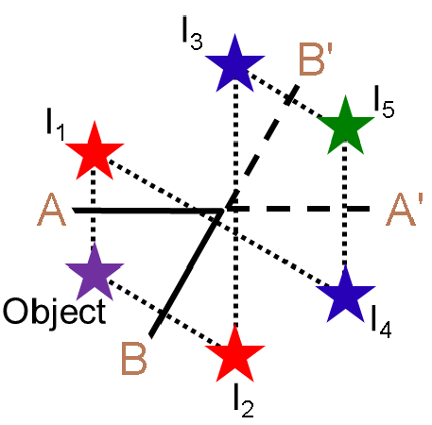
Question Title
Solution continued
Question Title
Two mirrors angled at 60 degrees (Option C) will produce five images, two from single reflections, two from double reflections and one composite image.
Images I₁ and I₂ are formed by the single reflection of the object on mirrors A and B, respectively.
Images I₃ and I₄ are formed by the reflection of I₁ and I₂ on mirrors A and B (and their imaginary extensions, A' and B') respectively. This is the same as the double reflection in option B.
Image I₅ is a composite image, created by the reflections of I₃ and I₄ on mirrors A' and B' (notice that they create the same image – they overlap!).

Slide 20
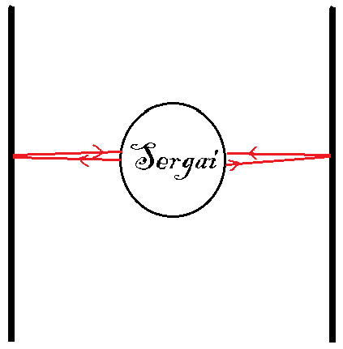
Question Title
Solution continued
Question Title
Two mirrors parallel to one another (Option D) will produce infinite images as the two mirrors continuously reflect the other mirror's image.
So option D produces the most images.
But the question asked for the most images that Sergai can see. And if Sergai is both the object and the observer, he will not be able to see the infinite reflection in D as his body will block the images from reflecting back and forth and then into his eye.
So then Option C, where there are 5 visible images, is the best option.

Slide 21
Question Title
Optics Problems V
Question Title
A new type of transparent plastic has been developed. When light travels through it, it only travels at 2 × 10⁷ m/s. What is the refractive index (n) of this new plastic?
n = 0.67
n = 1.5
n = 6.67
n = 15

Slide 22
Question Title
Solution
Question Title
Answer: D
Justification: An object's index of refraction is described using Snell's Law, which relates the speed of light in a material to the speed of light in a vacuum:
Thus to find the refractive index of our new plastic, we need to divide the speed of light in a vacuum (c), by the speed that light travels in the medium (v).
It is important to remember our orders of magnitude, as the speed that light travels in this plastic is an order of 10¹ smaller than c, since we know that c = 300,000,000 m/s = 3 × 10⁸ m/s

Slide 23
Question Title
Solution continued
Question Title
To find the refractive index:
Therefore the correct answer is D.

Slide 24
Question Title
Optics Problems VI
Question Title
A beam of light is shone through the new plastic (from the previous question) at a 30 degree angle from the normal. Assume that we are testing this new plastic in a vacuum chamber. Using your knowledge of the refractive index from the previous question, which diagram most accurately represents how the light will be refracted in the new plastic?
A.
B.
30º
30º
Air
Air
Plastic
Plastic
C.
D.
30º
30º
Air
Air
Plastic
Plastic

Slide 25
Question Title
Solution
Question Title
Answer: A
Justification: When light passes from one medium to another, such as from outside to inside our new plastic, the refractive index determines what angle it is bent at, following Snell's Law:
We know that because the refractive index of the plastic, which we found in the previous question to be 15, is (much) larger than that of vacuum (which is 1), the light must be bent towards the normal. This immediately rules out two possible answers, as in answer C, the light is not refracted at all, and in answer D, the light is refracted away from the normal.
Thus, we can analyze answers A and B to determine the correct answer. We can deduce that A is the correct answer if we remember that a refractive index of 15 is extremely large, much larger than that found in common materials (for example silicon only has a refractive index of around 3.45). Thus, the light will be refracted very close to the normal, and answer A is our correct answer.

Slide 26
Question Title
Solution continued
Question Title
If we wanted to do an actual calculation to confirm our idea, we would use Snell's law as seen below:
n₁ = 1 (refractive index of a vacuum)
Ɵ₁ = 30º
n₂ = 15
Therefore we can see that A is the correct answer.

