Slide 1
Physics Waves
FACULTY OF EDUCATION
Department of
Curriculum and Pedagogy
Science and Mathematics Education Research Group
Supported by UBC Teaching and Learning Enhancement Fund 2012-2015
Notes:
Categories: Secondary – Physics – Waves
Tags: Secondary, Physics, Waves, Principle of Superposition
Excerpt: Find out how to describe the shape of a new wave when one wave is superimposed on another.

Slide 2
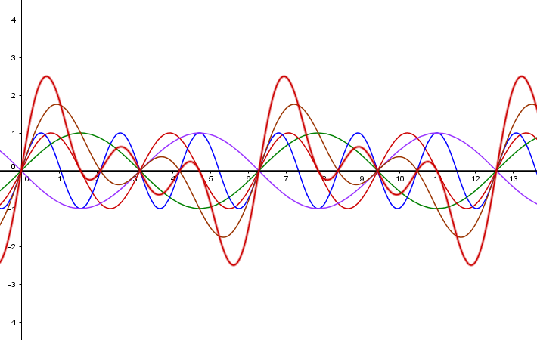
Question Title
Waves
Question Title

Slide 3
Question Title
Waves
Question Title
The following questions have been compiled from a collection of questions submitted on PeerWise (https://peerwise.cs.auckland.ac.nz/) by teacher candidates as part of the EDCP 357 physics methods courses at UBC.

Slide 4
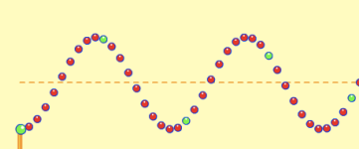
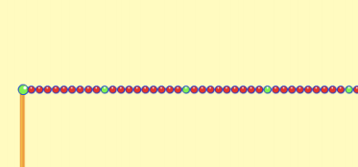
Question Title
Waves Problems I
Question Title
Consider the snapshot of a wave:
Which of the following could be superimposed (added) on the above wave in order to achieve the following "wave"?
(Options are on the next slide.)

Slide 5
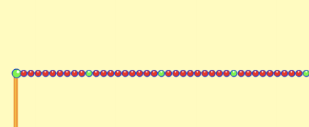
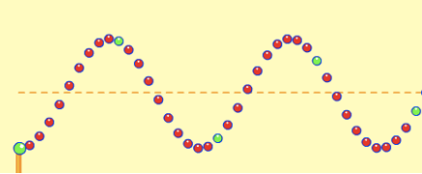
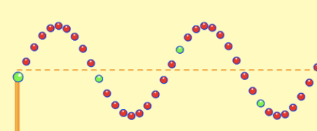
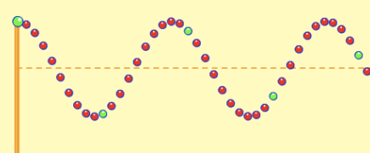
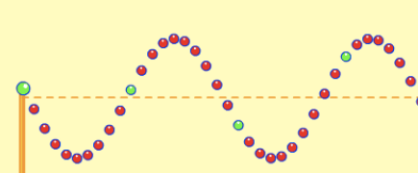
Question Title
Waves Problems I (cont.)
Question Title
A
D
B
E
C

Slide 6
Question Title
Solution
Question Title
Answer: E
Justification: The principle of superposition is sometimes stated as:
When two waves interfere, the resulting displacement of the medium at any location is the algebraic sum of the displacements of the individual waves at that same location.
We are looking for a wave that would produce destructive interference. Destructive interference is a type of interference that occurs at any location along the medium where the two interfering waves have a displacement in the opposite direction.
Thus, E is the correct answer.

Slide 7
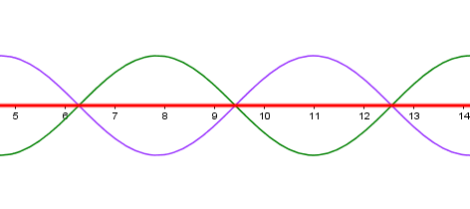
Question Title
Solution continued
Question Title
Answer: E
In our case, the two waves (given wave and option E) have the same displacements but in opposite directions. We can see this if we note the positions of the green-colored balls (particles) that move as the wave passes. When we superimpose these two waves having equal and opposite displacements, the resulting displacement (red line) is canceled by the effect of one another.
Thus, E is the correct answer.
Try it out for yourself: http://phet.colorado.edu/sims/wave-on-a-string/wave-on-a-string_en.html

